Slide 1
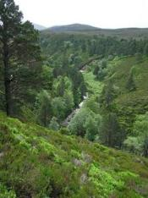
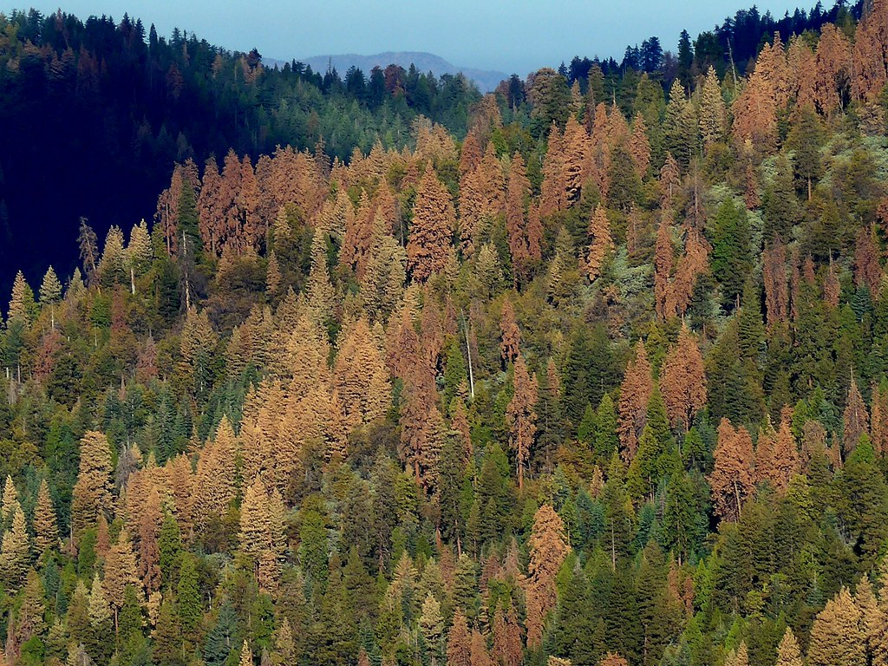

Probabilistic Risk Analysis (PRA) and Bayesian Decision Theory (BDT)
Marcel van Oijen
(Independent scientist,
Edinburgh, U.K.)
Mark Brewer
(Biomathematics and
Statistics Scotland)
USGS CC PDM 1.0
Workshop IBS-Germany & DVFFA, Lübeck, 2025-09-24-26

Slide 2
Contents
1. Introduction to PRA: Basic ideas & equations
2. Model-based PRA - 1
3. (a) Model-based PRA - 2
(b) Expanding the theory
4. (a) Introduction to BDT
(b) Links between PRA and BDT
(c) General discussion
Contents based on Van Oijen & Brewer (2022) with extensions, and some corrections
Exercises - simple calculation or R-programming - to initiate discussion
Main question to all: What is missing from these lectures and/or VO & B (2022)?

Slide 3
1. Introduction to PRA: Basic ideas & equations
USGS CC PDM 1.0
Workshop IBS-Germany & DVFFA, Lübeck, 2025-09-24-26

Slide 4
Risk matrices
National Risk Register (2017)
CAA (2014)

Slide 5
Risk matrices
p[H] × V = 3 × 4
p[H] × V = 4 × 3
p[H] × V = 5 × 2
What is the highest risk??
V
p[H]

Slide 6
Risk matrices
Can we define V and p[H] such that Risk = V * p[H] is well-defined ?
V
p[H]

Slide 7
Terminological confusion
HAZARD | PROBABILITY OF HAZARD | VULNERABILITY
Initiating event | Probability of undesirable consequences | (Severity of) consequences
Threatening event | Exposure | (Degree of) loss
Natural hazards |  | Biophysical v. Socio-economic v.
Natural disaster |  | Sensitivity
Potentially damaging agent |  | Susceptibility (to damage)
 |  | Fragility
 |  | Impact
 |  | Damageability

Slide 8
Lecina-Diaz et al. (2020)
where E are the exposed values (here represented by the ES
provided by a forest), HM is the hazard magnitude (weighted
by its probability distribution), S is susceptibility, and LAC is
the lack of adaptive capacity within a given time frame

Slide 9
PRA: basic equations
Standard definition of risk
Standard definition of hazard probability
Logical definition of vulnerability
Vulnerability (V) is the difference in expected system performance (E[z|.]) between non-hazardous (¬H) and hazardous conditions (H).

Slide 10
Data needs are minimal for basic PRA
Cause
Effect
“Hazardous conditions” = “rainfall <= 2 mm d⁻¹”
A:
B:
C:
D:
E:
E(sys|env non-hazardous) = 9 g m⁻² d⁻¹
E(sys|env hazardous) = 3 g m⁻² d⁻¹
Vulnerability = A-B = 6 g m⁻² d⁻¹
p[env hazardous] = 0.3
Risk = C*D = 1.8 g m⁻² d⁻¹
Note that Risk can also be calculated in the standard way as E[sys|env non-hazardous] – E[sys] = 9 - 7.2 = 1.8

Slide 11
A simple method for risk decomposition
E[sys]
RISK = Average loss
VULNERABILITY
thr
p[Hazardous] =
frequency env < thr =
n_{H} / n
RISK =
VULNERABILITY * p[Hazardous]

Slide 12
Toward UQ (Uncertainty Quantification)
thr
n_{H} observations below threshold
n-n_{H}
observations above threshold

Slide 13
Toward UQ (Uncertainty Quantification)
E[sys]
R
V
thr
p[H] = n_{H} / n

Slide 14
Uncertainty Quantification (UQ)
E[sys]
R
V
thr
p[H] = n_{H} / n

Slide 15
UQ: 1000 datasets from same distribution, thr=1
p[H] = 0.27, V = 0.464, R = 0.124
𝞂_{pH} = 0.04 , 𝞂_{V} = 0.040, 𝞂_{R} = 0.018
p[H] = 0.33, V = 0.410, R = 0.135
𝞂_{pH} = 0.05. , 𝞂_{V} = 0.035, 𝞂_{R} = 0.019
p[H] = 0.27, V = 0.464, R = 0.124
𝞂_{pH} = 0.04 , 𝞂_{V} = 0.039, 𝞂_{R} = 0.019

Slide 16
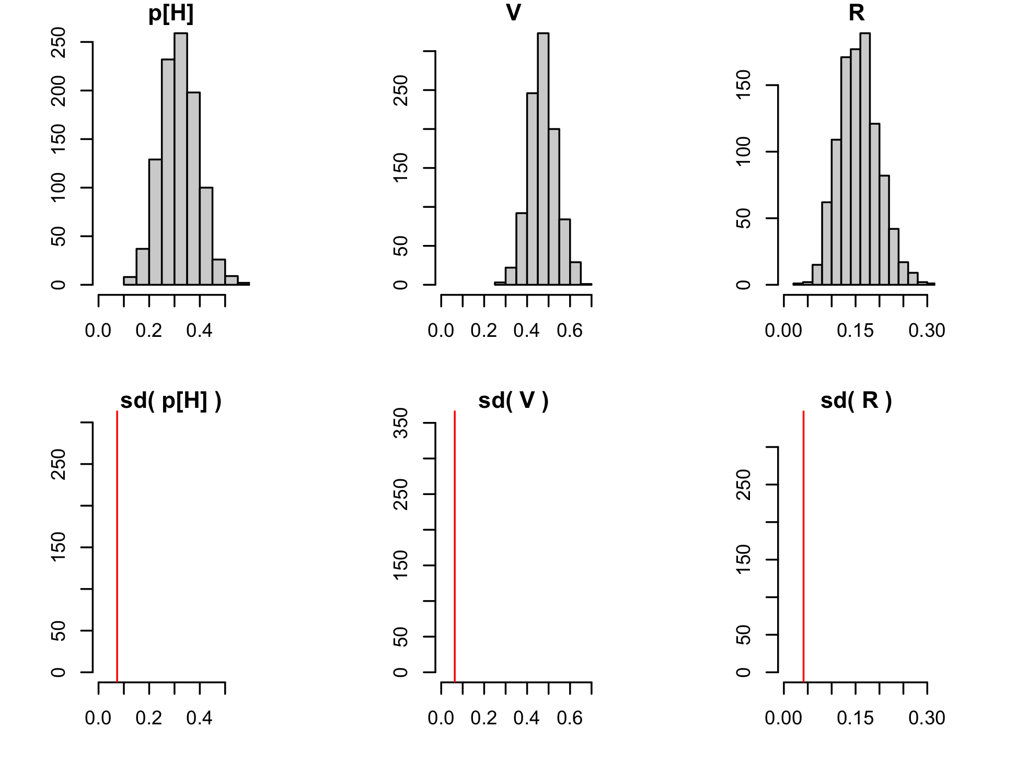
UQ: 1000 datasets from same distribution, thr=1

Slide 17
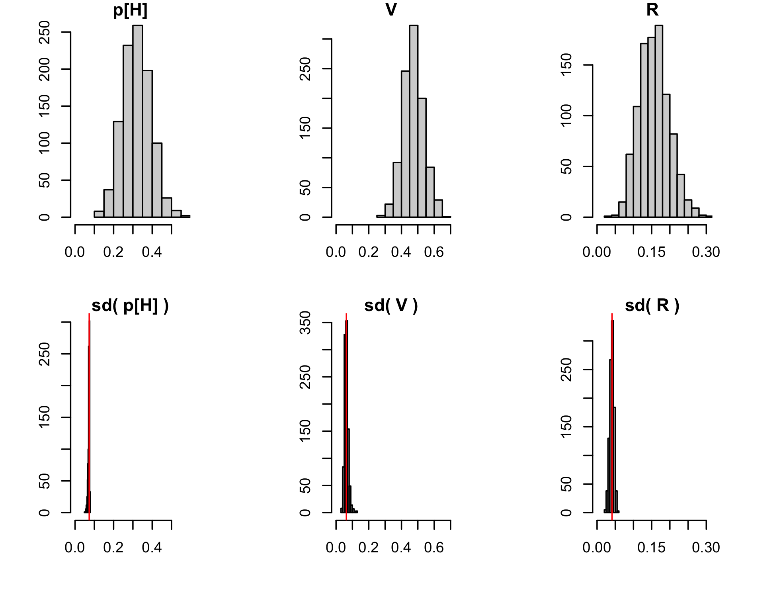
UQ: 1000 datasets from same distribution, thr=1

Slide 18
Example: Risk analysis for NPP
NPP in good years
VULNERABILITY
(= Difference NPP good-bad)
RISK
(= Prob.*VULNERABILITY)
NPP in bad years
Probability of bad years

Slide 19
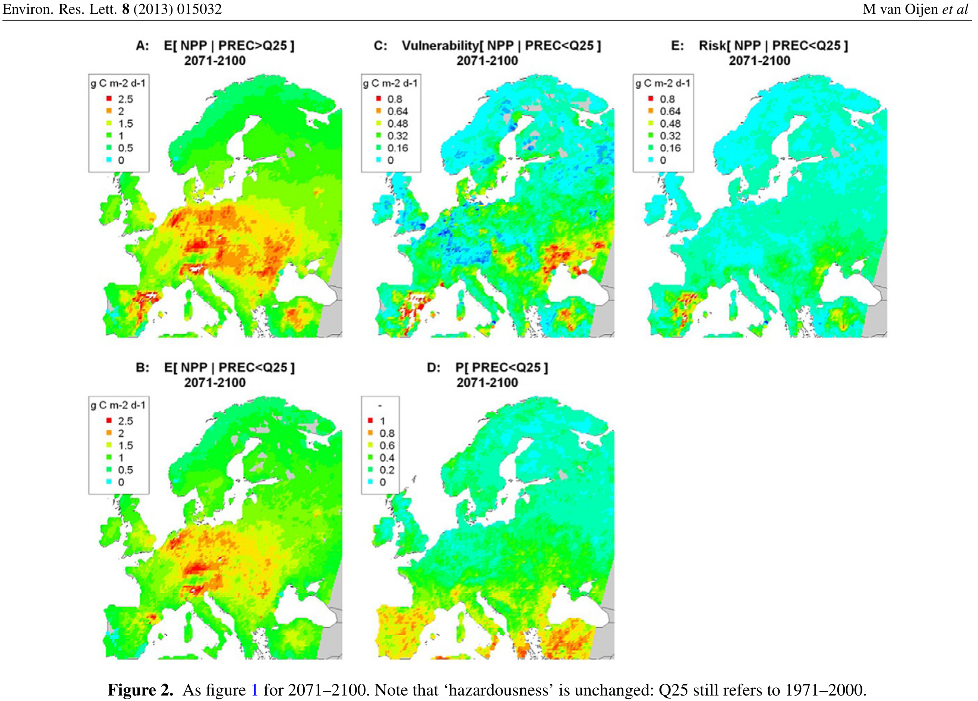

Slide 20
PRA before & after project PRAFOR
Risk = Expected loss = probability(Hazard) * Vulnerability
R = E[z|not H] - E[z] = p[H] * V
V = R / p[H] = E[z|not H] - E[z|H]
p(Drought)
Risk
Vulnerability
Van Oijen et al. (2013, 2014)
Mathematical formulas and R-code for:
Deriving p[H], V and R from data (3 methods)
Extending the PRA from 1 hazardous condition to 2 or more
Extending the PRA from 2 risk-components to 3
Uncertainty quantification

Slide 21
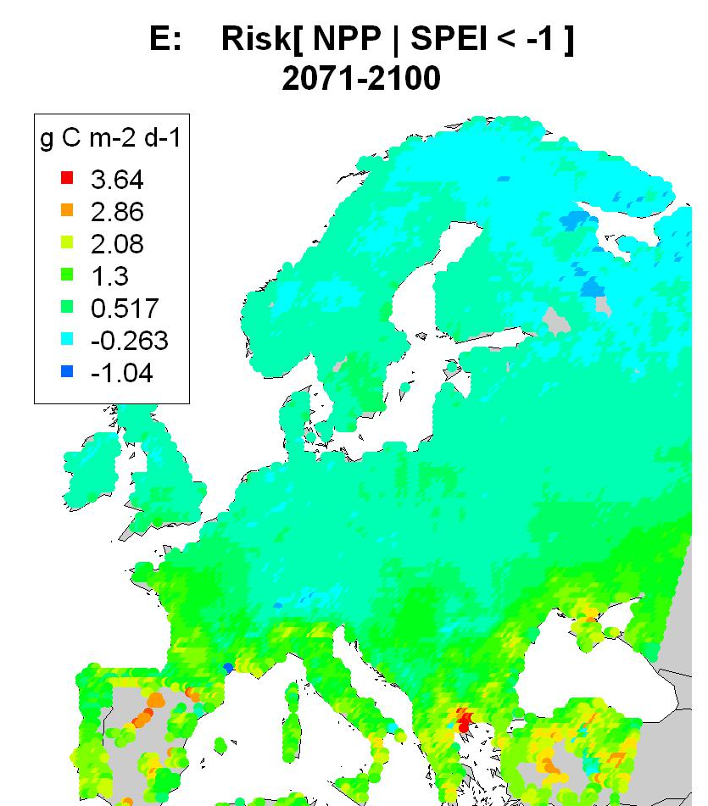
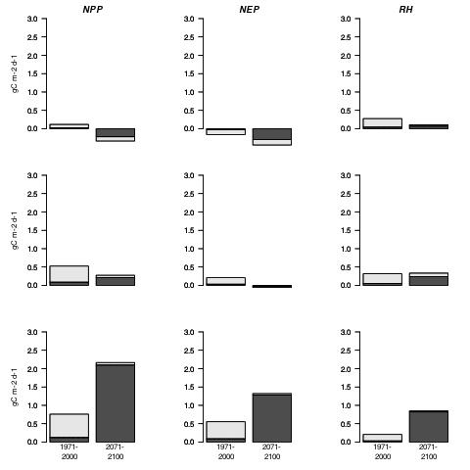
Risk analysis NPP (model LPJ) per latitudinal band
latitude > 55 °N
VULNERABILITY (high-latitude)
RISK (high-latitude)
45 < lat. < 55 °N
latitude < 45 °N
VULNERABILITY (mid-latitude)
RISK (mid-latitude)
VULNERABILITY (low-latitude)
RISK (low-latitude)

Slide 22
Risk analysis NPP (model LPJ) per latitudinal band
Left: 1971-2000, Right: 2071-2100

Slide 23
6 models: average NPP in 1971-2000
Van Oijen et al. (2014)
Biogeosciences

Slide 24
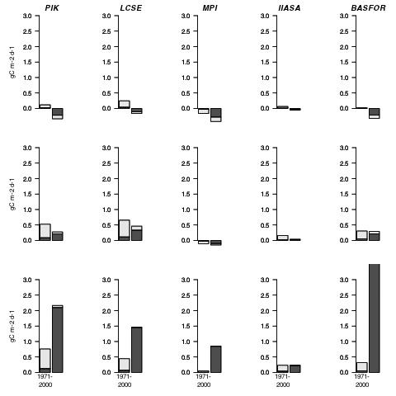
Risk analysis NPP: 5 models
LPJ
(generic)
ORCHIDEE
(generic)
JSBACH
(generic)
EPIC
(wheat)
BASFOR
(pine)

Slide 25
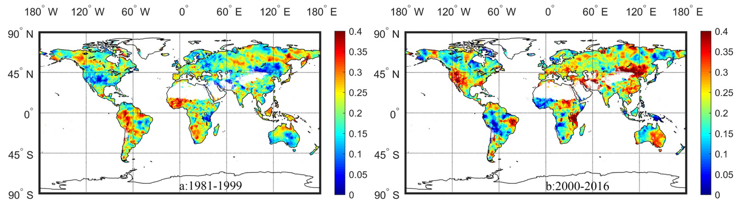
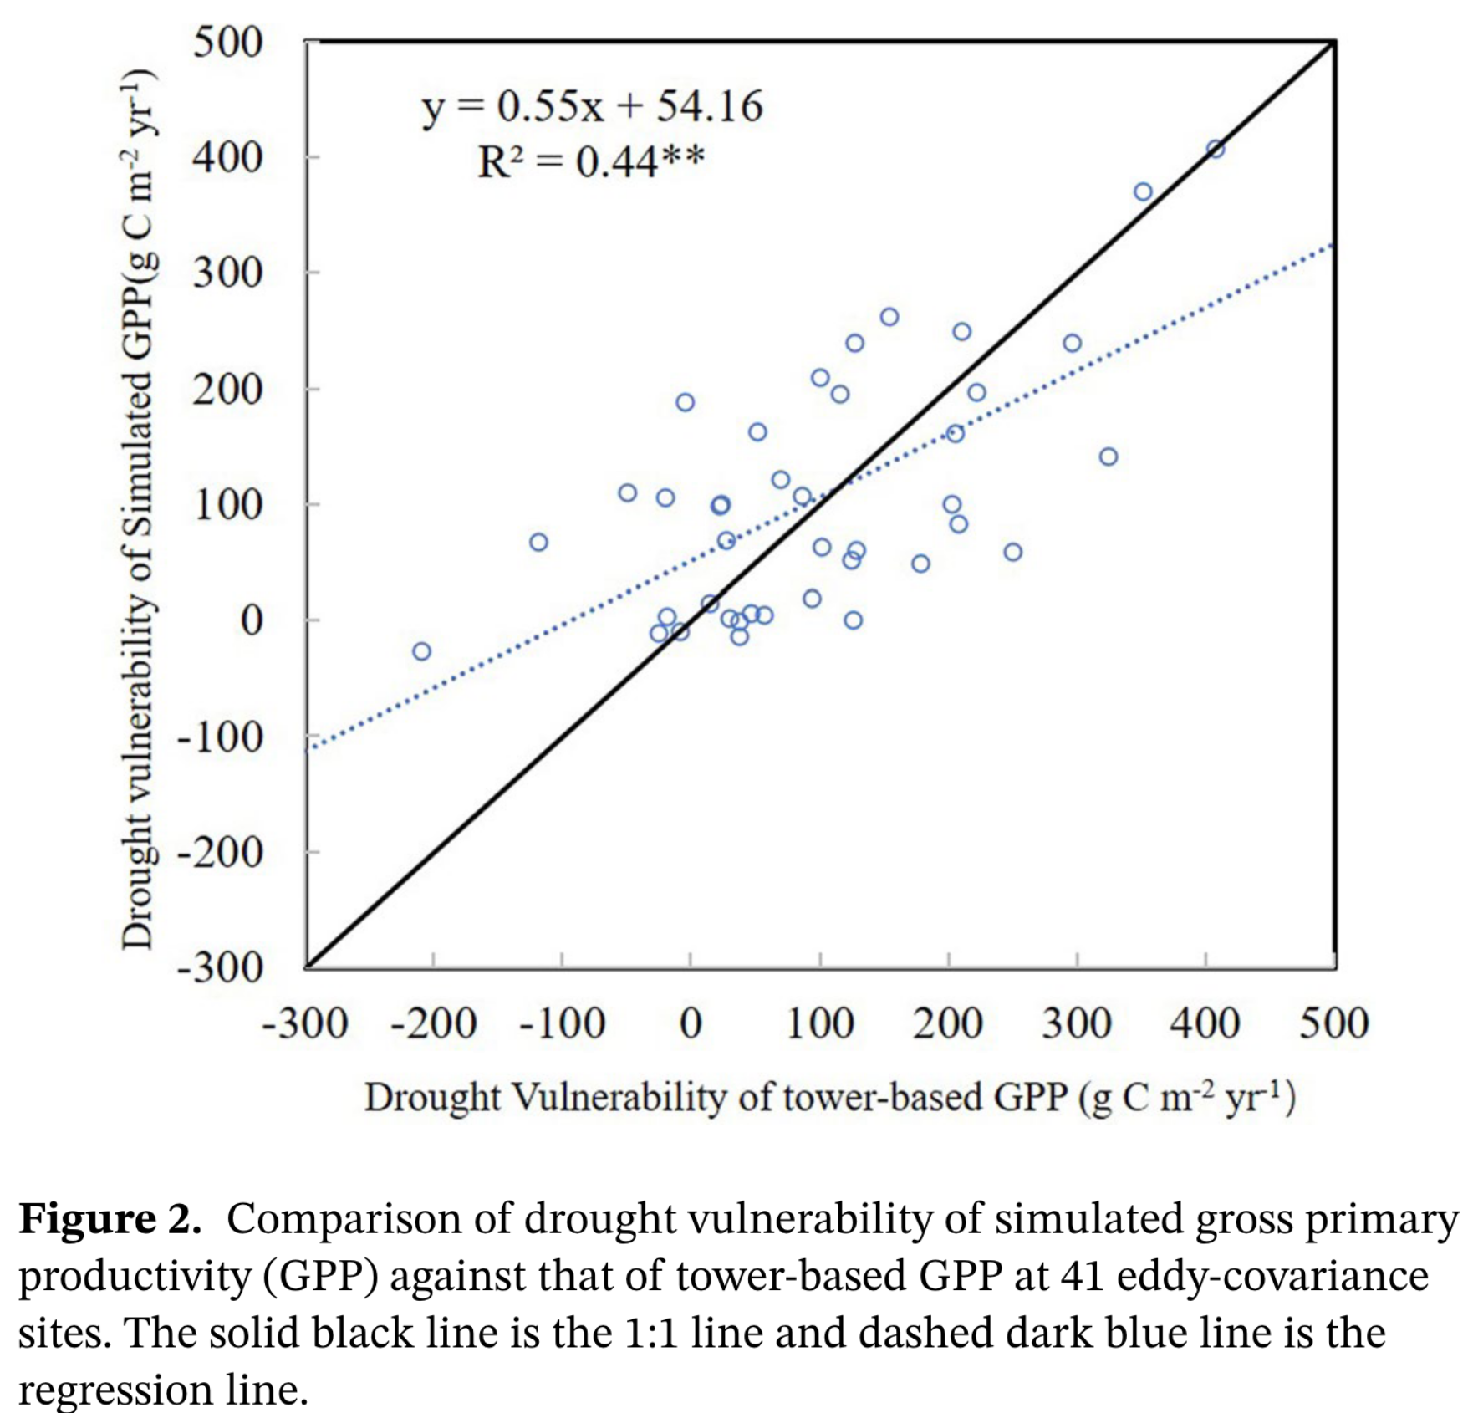
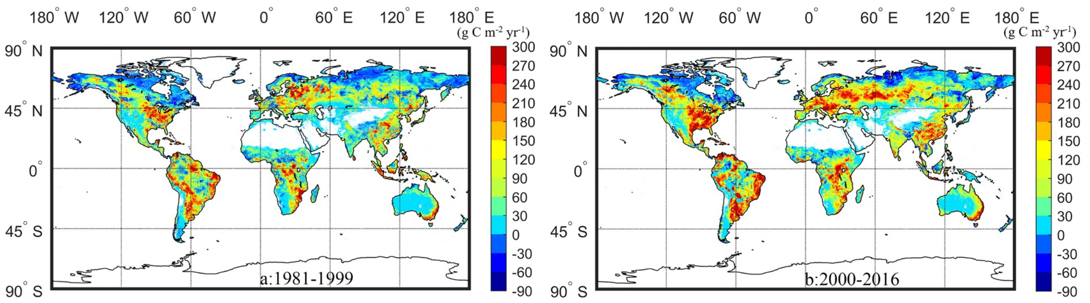
He et al. (2021). Drought Risk of Global Terrestrial Gross Primary Productivity Over the Last 40 YearsDetected by a Remote Sensing-Driven Process Model
1981-1999
2000-2016
p[H]
V

Slide 26
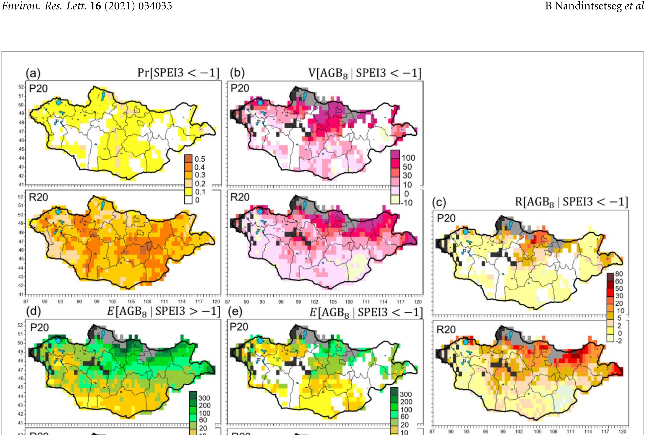
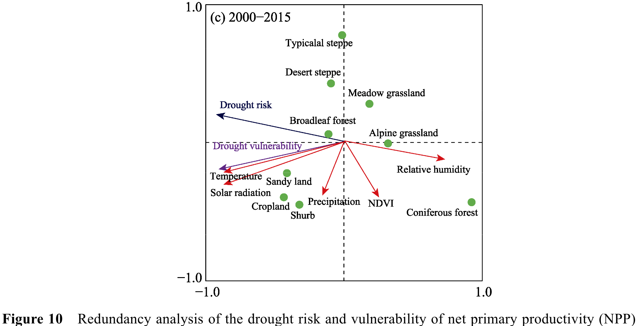
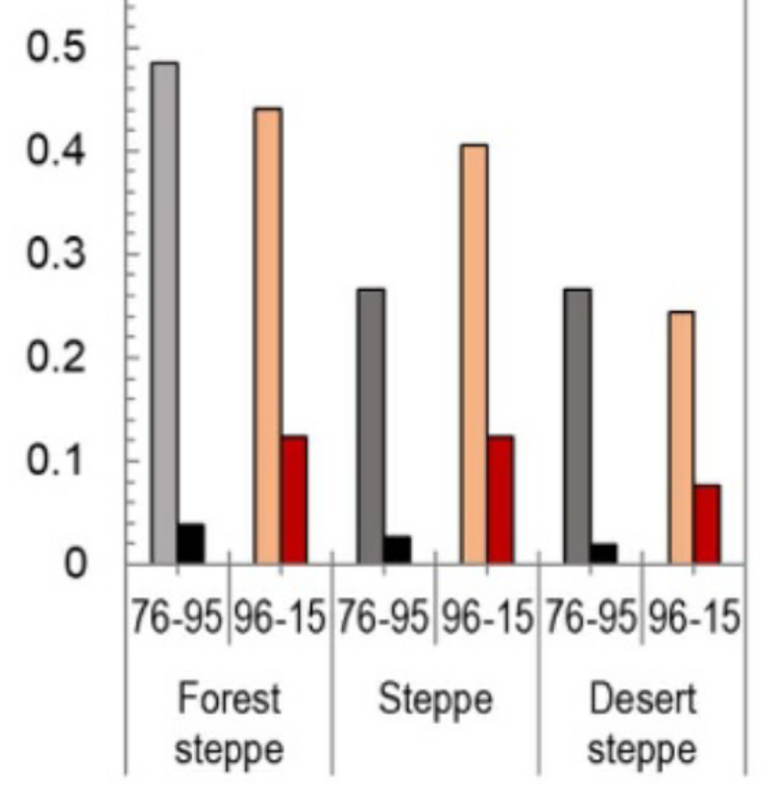
Nandintseg et al. (2021). Risk and vulnerability of Mongolian grasslands under climate change
p[H]
V
R
1976-1995
1996-2015
V
R
Ren et al. (2023)

Slide 27
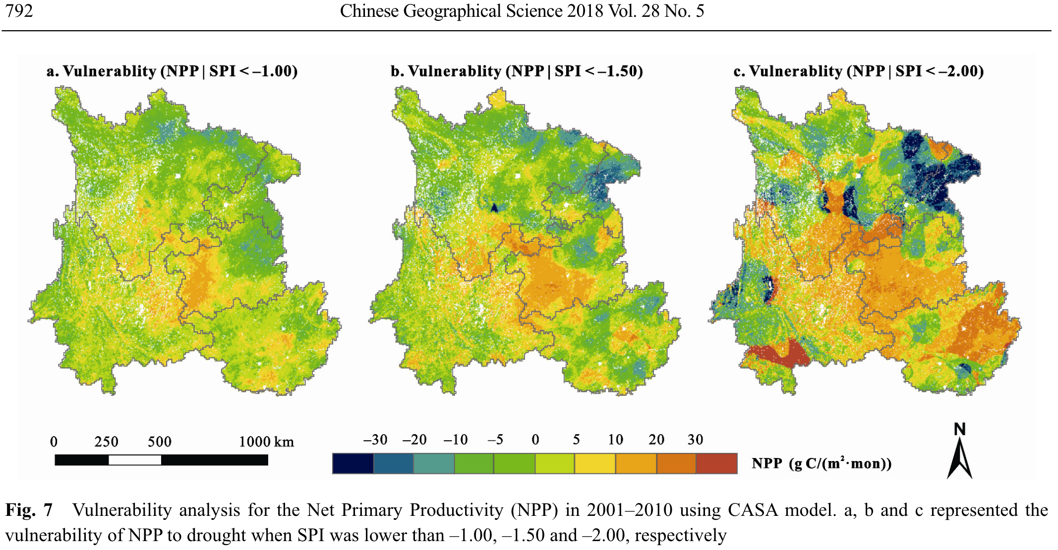
Zhou et al. (2018). Drought Impacts on Vegetation Indices and Productivity of Terrestrial Ecosystems in Southwestern China During 2001–2012

Slide 28
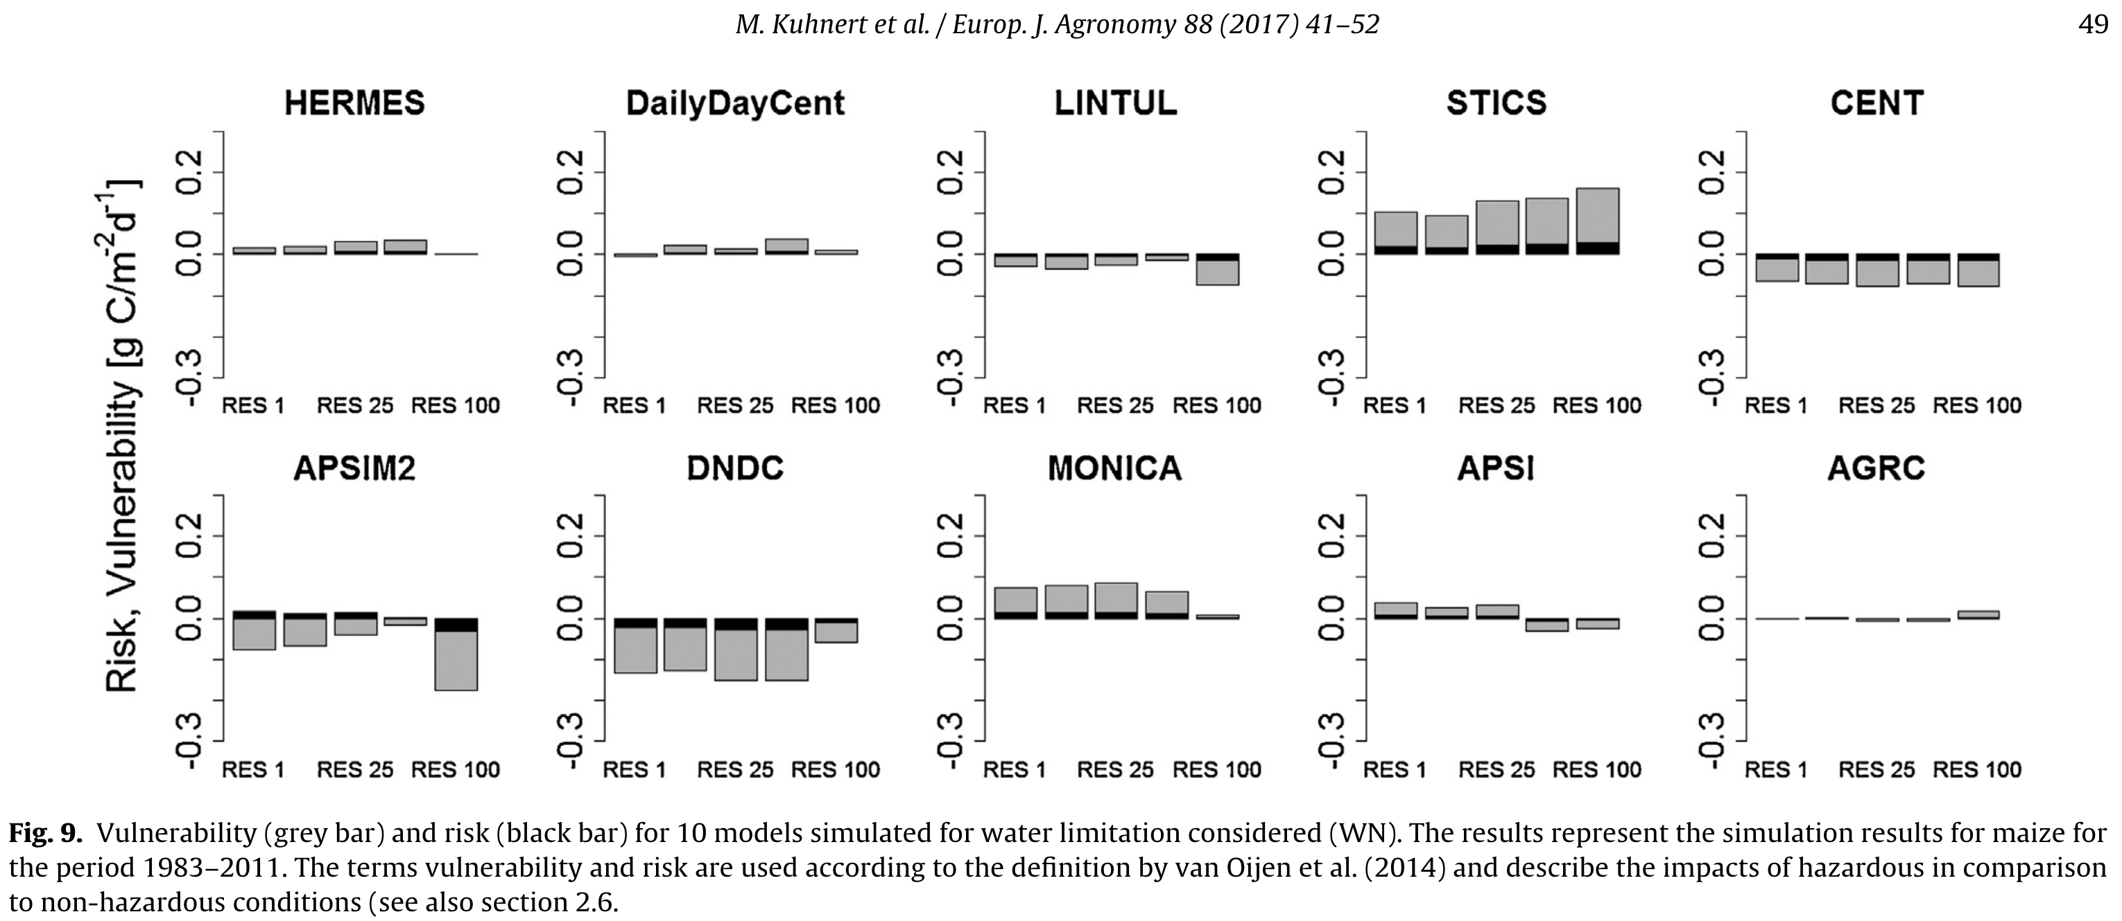
Kuhnert et al. (2017). Impact analysis of climate data aggregation at different spatial scales on simulated net primary productivity for croplands
Drought risk to NPP of maize in North Rhine-Westphalia
V,
R

Slide 29
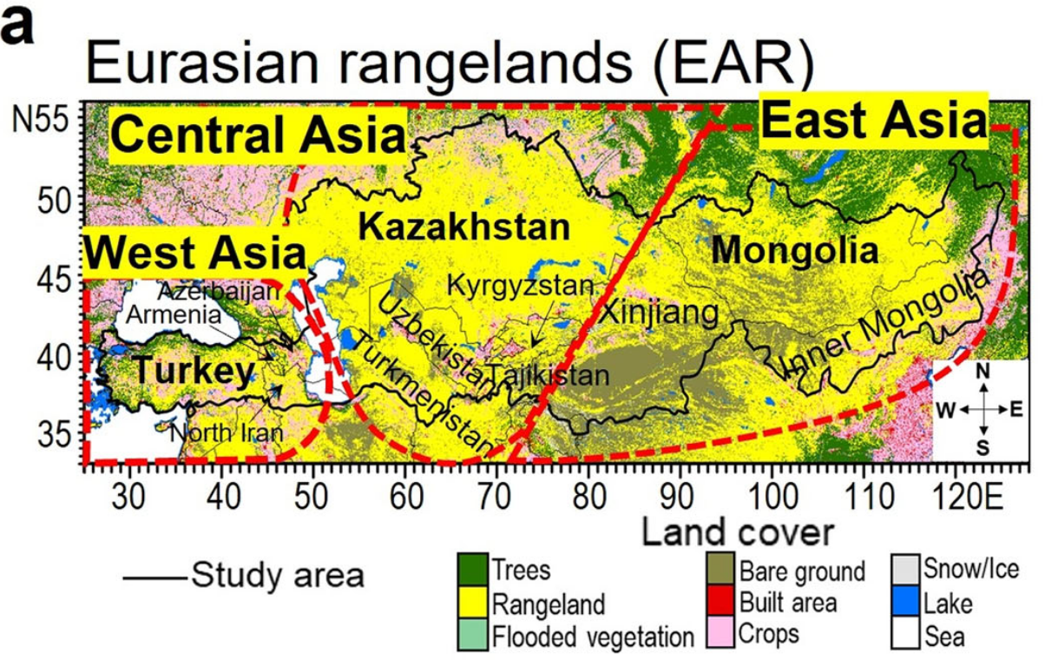
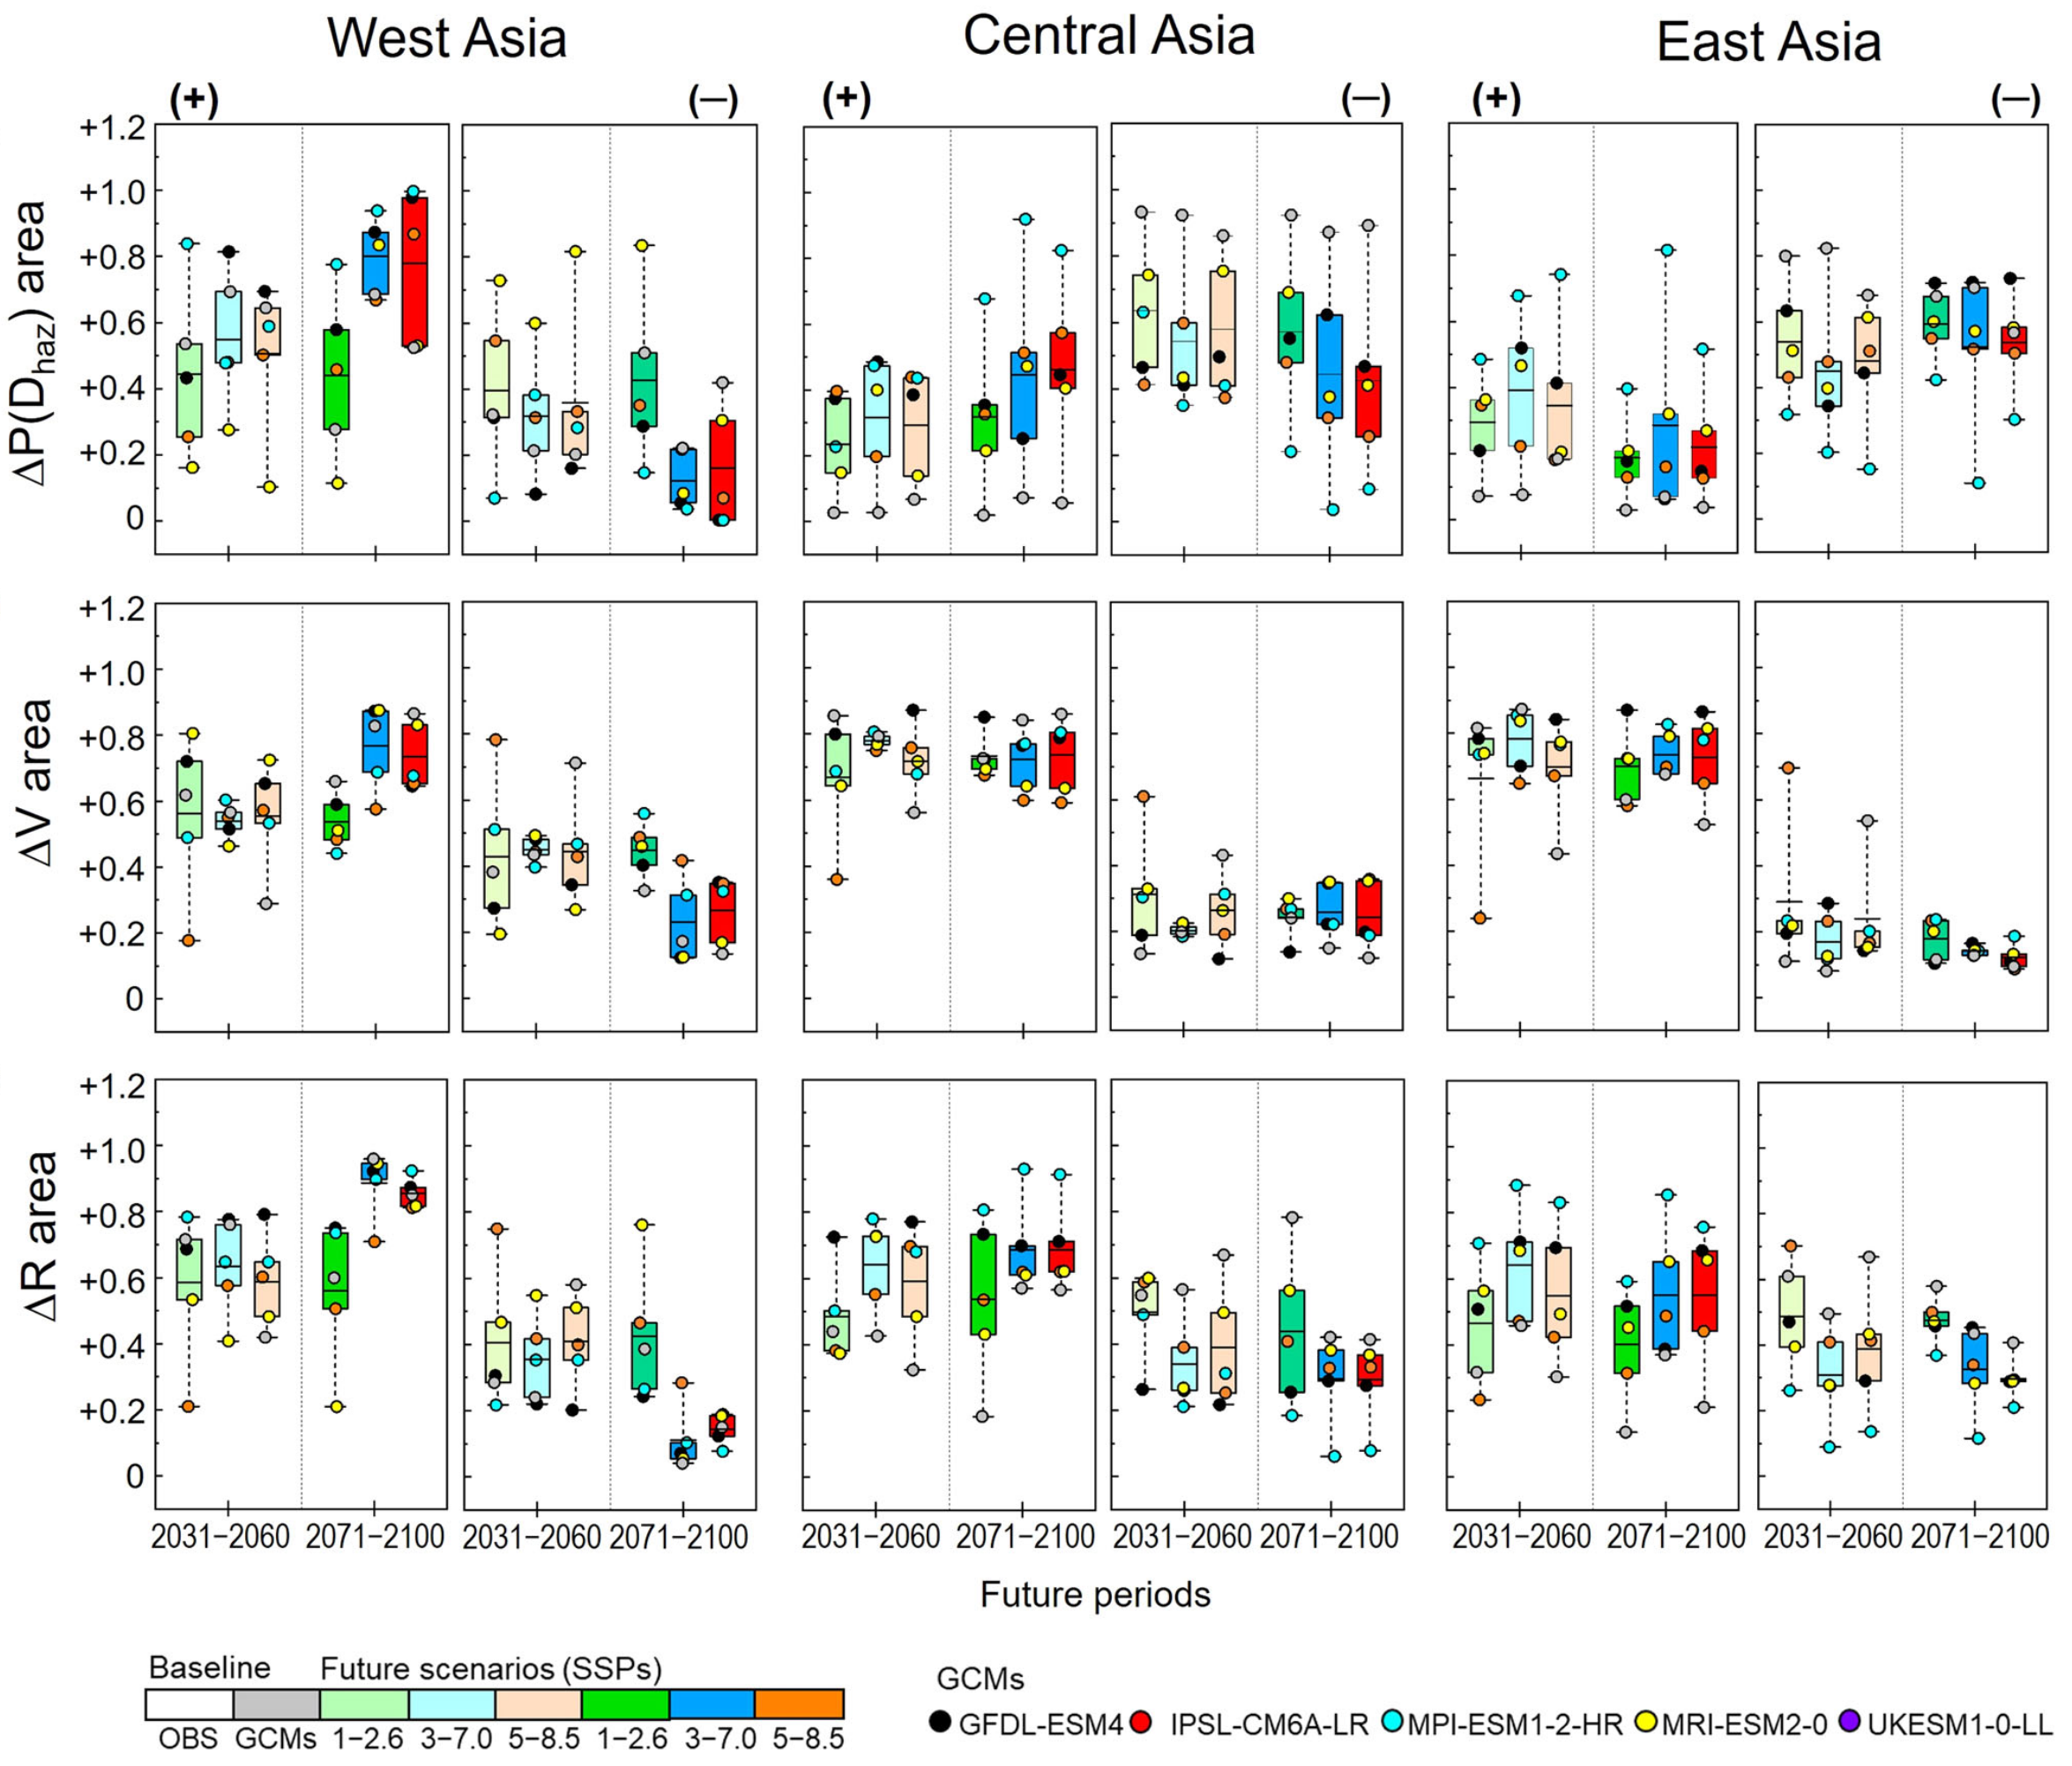
Nandintseg et al. (2024). Future drought risk and adaptation of pastoralism in Eurasian rangelands
Uncertainty p[H]
Uncertainty p[H]

Slide 30
EXERCISE. Minimal data sets (sampling-based PRA)
x <- c( 200, 600 )
z <- c( 70, 90 )
PRA( x, z, 500 )
Will the uncertainty quantification work?
x <- c( 200, 400, 600, 800 )
z <- c( 70, 80, 90, 100 )
PRA( x, z, 500 )
Will the uncertainty quantification work?

Slide 31
EXERCISE. Minimal data sets (sampling-based PRA)
x <- c( 200, 600 )
z <- c( 70, 90 )
PRA( x, z, 500 )
pH V R s_pH s_V s_R
0.5 20.0 10.0 0.3535534 NA NA
x <- c( 200, 400, 600, 800 )
z <- c( 70, 80, 90, 100 )
PRA( x, z, 500 )
pH V R s_pH s_V s_R
0.5 20.0 10.0 0.25 7.0710678 6.373774

Slide 32
EXERCISE: Forest data from Germany - 1
https://www.umweltbundesamt.de/daten/klima/
2-bis-7_abb-tab_nsh_2024-04-08.xlsx
https://wo-apps.thuenen.de/apps/wze/
absterberate_EI_GFI_GKI_RBU_zeitreihe.csv
library( readxl )
d.data <- "data_Germany/"
file.data <- paste0( d.data, "2-bis-7_abb-tab_nsh_2024-04-08.xlsx" )
sheet.data <- "5_Daten"
r.data <- "B120:C153"
y_r <- read_excel( file.data, sheet=sheet.data, range=r.data,
col_names=F )
y_r <- round( as.matrix(y_r) )
colnames(y_r) <- c( "year", "rain.mm" )
file.data <- paste0( d.data, "absterberate_EI_GFI_GKI_RBU_zeitreihe.csv" )
y_m <- read.csv2( file.data )
colnames(y_m) <- c( "year", "mort.%.Fs", "mort.%.Q_", "mort.%.Pa", "mort.%.Ps" )
y_r_m <- cbind( y_r, y_m[ , startsWith( colnames(y_m), "mort" ) ] )

Slide 33
EXERCISE: Forest data from Germany - 1
# Annual mortality vs. summer rain of last three years
meanlast <- function(v,k){as.vector(filter(v,f=rep(1/k,k),s=1))}
n <- dim(y_r_m)[1] ; k <- 3
r.3 <- meanlast(y_r_m[,"rain.mm"],k)[k:n]
par ( mfrow=c(2,2) , mar=c(5,4,4,2) )
z.Fs <- y_r_m[k:n,"mort.%.Fs"]
plot( r.3, z.Fs, main="Fs", xlab="" , ylab="mortality (%)" )
z.Q_ <- y_r_m[k:n,"mort.%.Q_"]
plot( r.3, z.Q_, main="Q_", xlab="" , ylab="" )
z.Pa <- y_r_m[k:n,"mort.%.Pa"]
plot( r.3, z.Pa, main="Pa", xlab="rain (mm)", ylab="mortality (%)" )
z.Ps <- y_r_m[k:n,"mort.%.Ps"]
plot( r.3, z.Ps, main="Ps", xlab="rain (mm)", ylab="" )

Slide 34
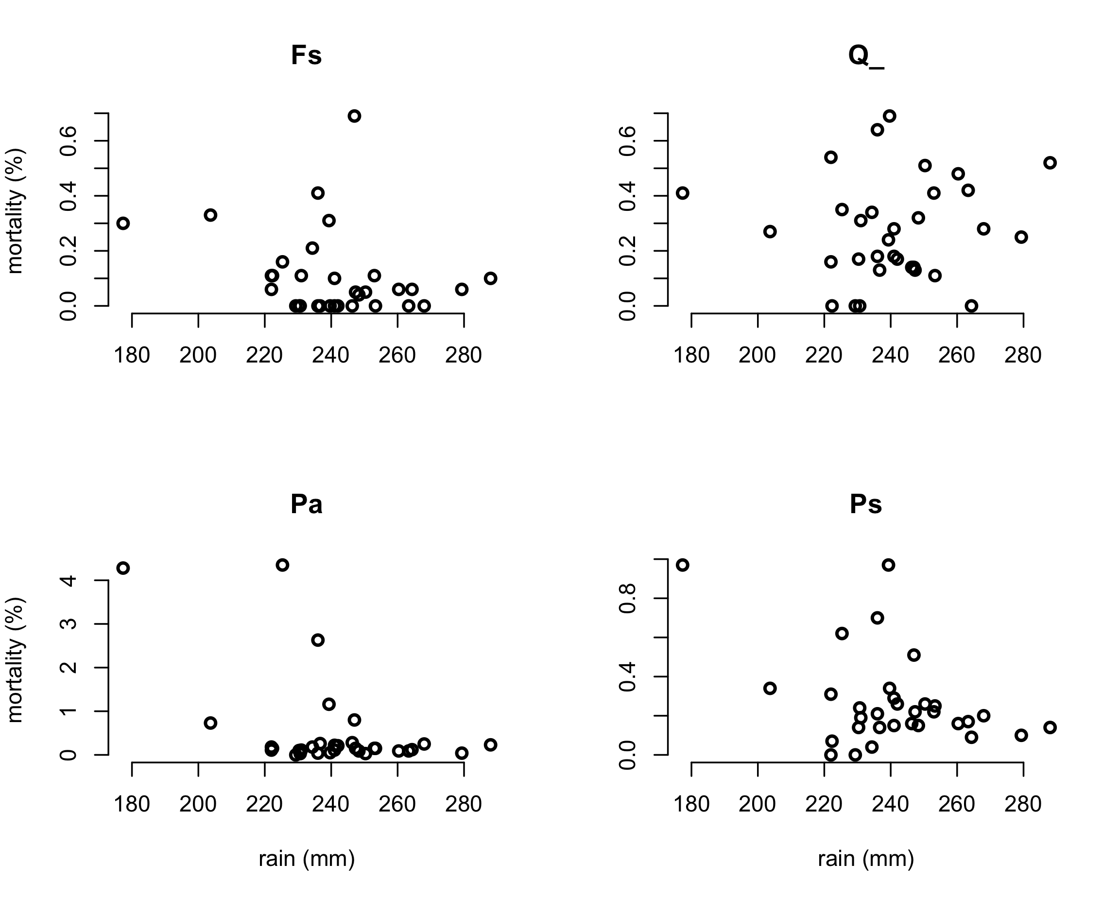
EXERCISE: Forest data from Germany - 1

Slide 35
EXERCISE: Forest data from Germany - 1
PRA <- function( x, z, thr=0 ) {
n <- length(x)
H <- which(x < thr) ; n_H <- length(H)
Ez_H <- mean( z[ H] ) ; s_Ez_H <- sqrt( var(z[ H]) / n_H )
Ez_notH <- mean( z[-H] ) ; s_Ez_notH <- sqrt( var(z[-H]) / (n-n_H) )
pH <- n_H / n
V <- Ez_notH - Ez_H
R <- pH * V
s_pH <- sqrt( pH*(1-pH) / n )
s_V <- sqrt( s_Ez_H^2 + s_Ez_notH^2 )
s_R <- sqrt( s_pH^2*s_V^2 + s_pH^2*V^2 + pH^2*s_V^2 )
return( c(pH=pH,V=V,R=R,s_pH=s_pH,s_V=s_V,s_R=s_R) )
}
# PRA for survival (= 100 - mortality)
PRA_Ss.Fs <- PRA( x_r3, 100-z_Fs, thr=250 )
PRA_Ss.Q <- PRA( x_r3, 100-z_Q , thr=250 )
PRA_Ss.Pa <- PRA( x_r3, 100-z_Pa, thr=250 )
PRA_Ss.Ps <- PRA( x_r3, 100-z_Ps, thr=250 )

Slide 36
EXERCISE: Forest data from Germany - 1
PRA._ <- as.matrix( cbind(PRA_Ss.Fs, PRA _Ss.Q_, PRA _Ss.Pa, PRA _Ss.Ps) )
colnames(PRA._) <- c( "Fs", "Q_", "Pa", "Ps" )
means <- PRA._[1:3,] ; s <- PRA._[4:6,]
par(mfrow=c(1,1))
col <- c( "red", "cyan", "yellow" )
bp <- barplot( means, beside=T, ylim=c(-0.2,1), col=col,
legend.text=row.names(means),
args.legend=list(x="top",hor=T) )
segments( bp, means - s, bp, means + s )
ew <- (bp[2,1]-bp[1,1])/4
segments( bp - ew, means - s, bp + ew, means - s )
segments( bp - ew, means + s, bp + ew, means + s )

Slide 37
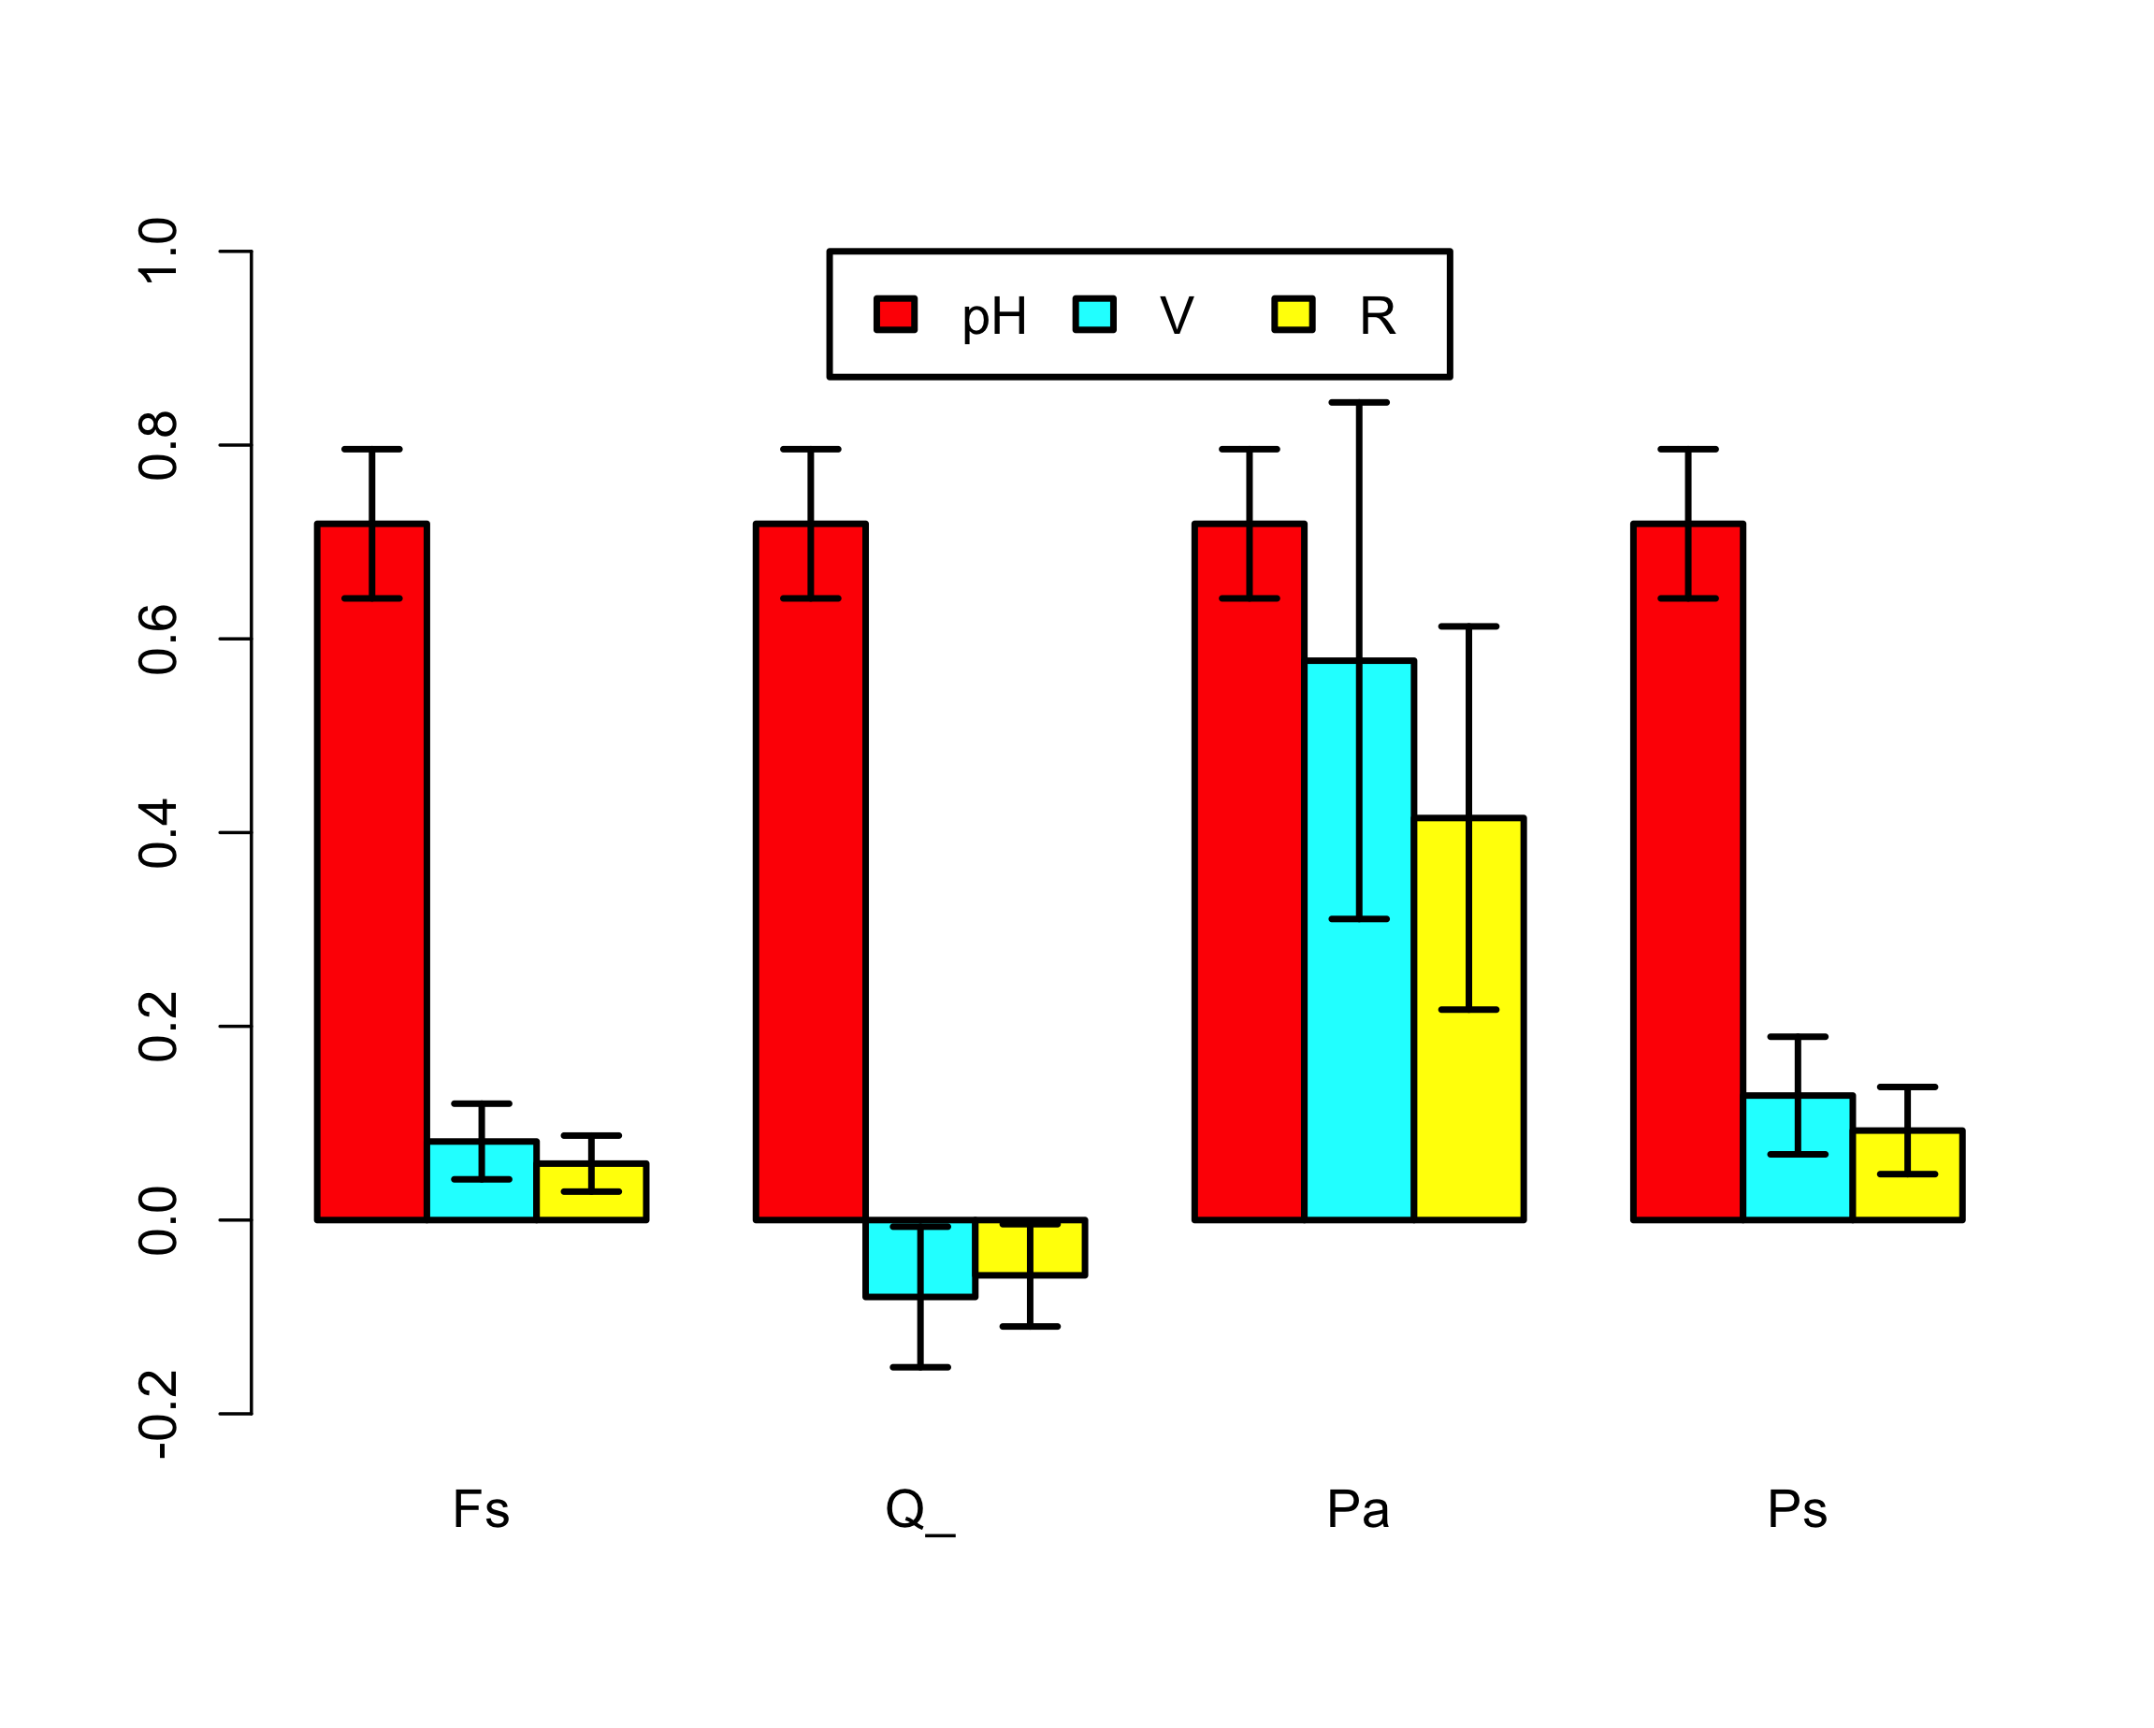
EXERCISE: Forest data from Germany - 1

Slide 38
EXERCISE: Forest data from Germany - 1
Discuss limitations of the PRA. Possible answers:
Low n, large uncertainties.
Germany-average weather and mortality even though the tree species grow in different areas. p[H] the same for all species.
Arbitrary definition of hazard (average of last three summer-rain totals is less than thr = 250 mm).
Just one single hazard threshold.
No mechanistic understanding of causal factors, no gradual build-up of stress (increase of V) over years, no interactions with other hazard variables such as pests and diseases, …
No local definition of drought threshold (e.g. SPEI).
No normalised definitions of V and R.
…
Change code: try other choices for the threshold.
Sometimes better! When?

Slide 39
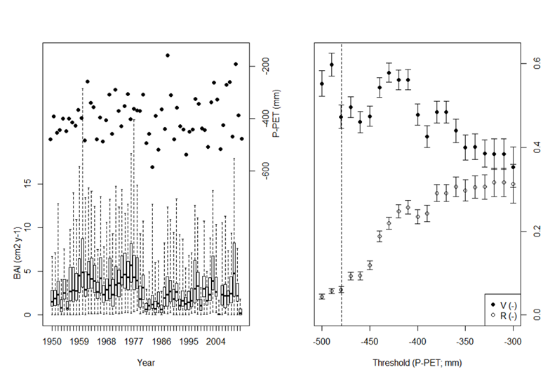
Van Oijen & Zavala (2019): P. sylvestris (El Carrascal, Spain)

Slide 40
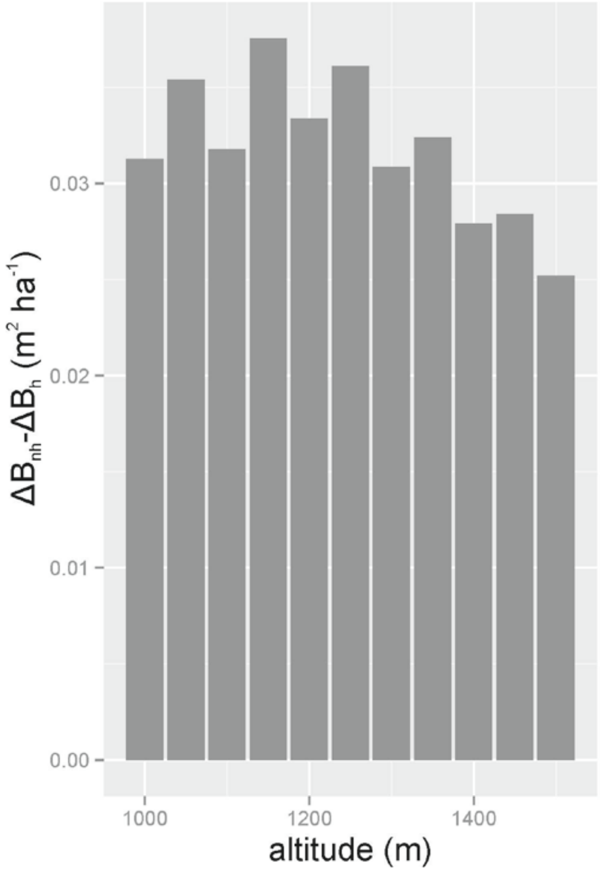
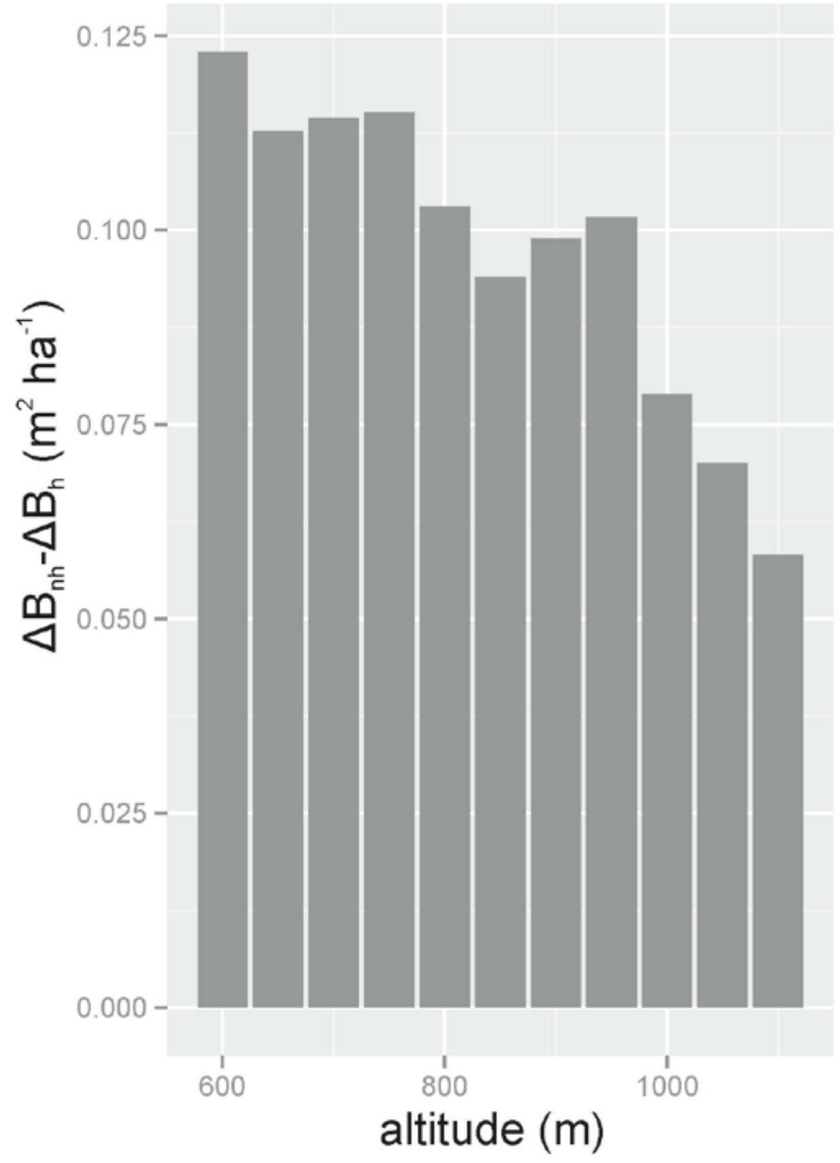
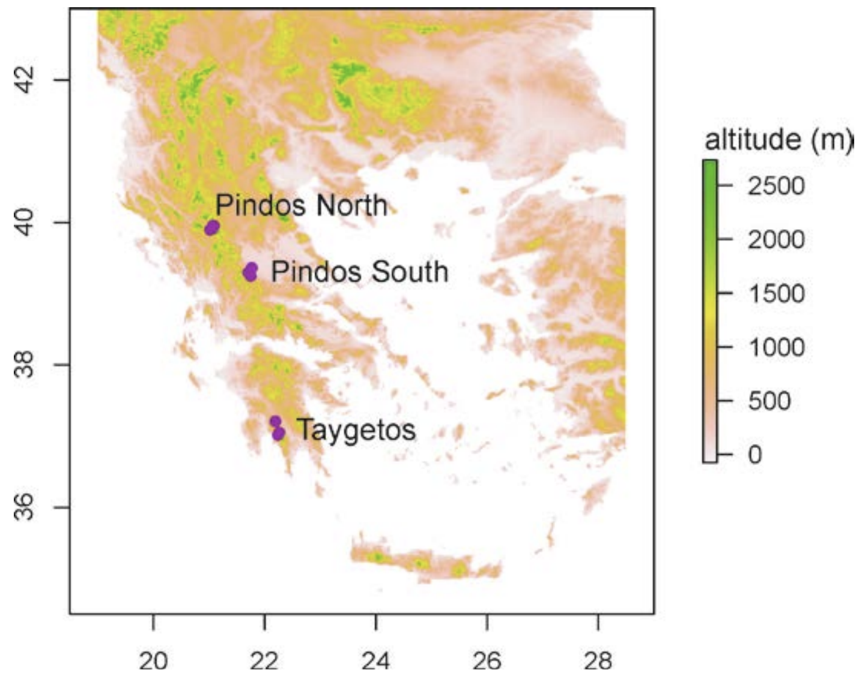
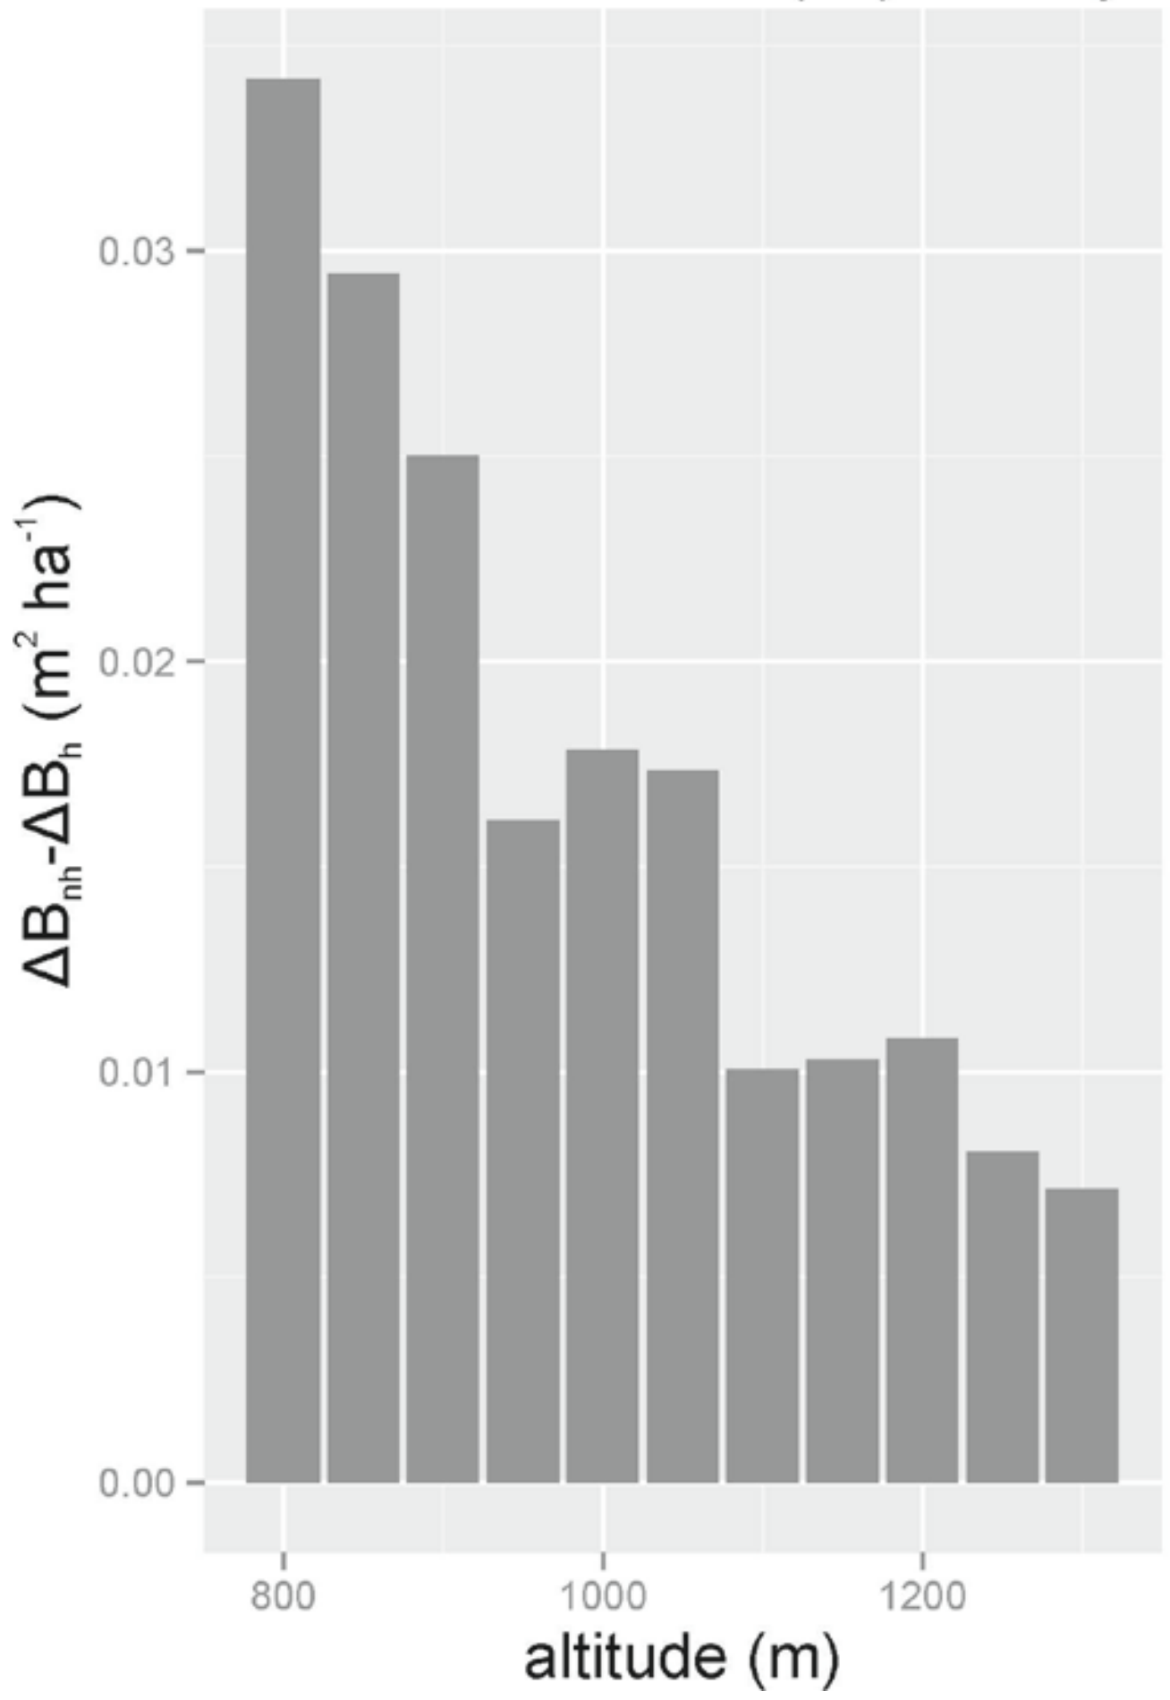
Fyllas et al. (2015). Mediterranean Forests in Transition (MEDIT): Deliverable No9
V
V
V

Slide 41
Deriving p[H], V and R from data (3 methods)

Slide 42
Deriving p[H], V and R from data (3 methods)
Fit a distribution p[x,z] to the data (*)
Calculate conditional expectations E[z|x]
Derive p[H], V and R
(*) Copulas can map any p[x] and p[z] to p[x,z]
So we have freedom to choose appropriate probability distributions for environment x and system z

Slide 43
Deriving p[H], V and R from data (3 methods)
Fit a model z = f(x,θ) to the data (*)
Calculate conditional expectations E[z|f(x)]
Derive p[H], V and R
(*) Bayesian calibration estimates the model’s parameters θ with uncertainty quantified
We used R-package ‘Nimble’

Slide 44
Uncertainty quantification
Distributional variances associated with p[x,z]
Sampling variances
Forward propagation of posterior parameter variances to model output variances

Slide 45
2a. Model-based PRA - 1
USGS CC PDM 1.0
Workshop IBS-Germany & DVFFA, Lübeck, 2025-09-24-26

Slide 46
2b. Expanding the theory
USGS CC PDM 1.0
Workshop IBS-Germany & DVFFA, Lübeck, 2025-09-24-26

Slide 47
Extending the PRA to 2 hazardous conditions or more

Slide 48
Extending the PRA to 2 hazardous conditions or more
Drought type 1
Drought type 2

Slide 49
Multiple-threshold PRA
Retrieving total (single-threshold) PRA

Slide 50
EXERCISE: Forest data from Germany - 2

Slide 51
EXERCISE: Forest data from Germany - 2
PRAm <- function( x, z, thr=-1:1 ) {
n <- length(x) ; n_thr <- length(thr)
H <- vector("list",n_thr)
n_H <- pH <- V <- R <- s_pH <- s_V <- s_R <- rep(NA,n_thr)
H[[1]] <- which( x < thr[1] ) ; n_H[1] <- length(H[[1]])
for(i in 2:n_thr) { H[[i]] <- which( thr[i-1] <= x & x < thr[i])
n_H[i] <- length(H[[i]])
}
n_notH <- n - sum(n_H)
H.all <- which( x < thr[n_thr] )
pH <- n_H / n
s_pH <- sqrt( pH*(1-pH) / n )
Ez_notH <- mean( z[-H.all] )
s_Ez_notH <- sqrt( var(z[-H.all] ) / n_notH )
for(i in 1:n_thr) {
Ez_Hi <- mean( z[ H[[i]]]) ; s_Ez_Hi <- sqrt( var(z[ H[[i]]]) / n_H[i] )
V[i] <- Ez_notH - Ez_Hi ; s_V[i] <- sqrt( s_Ez_notH^2 + s_Ez_Hi^2 )
}
R <- pH * V
s_R <- sqrt( s_pH^2 * s_V^2 + s_pH^2 * V^2 + pH^2 * s_V^2 )
R.sum <- sum(R) ; pH.sum <- sum(pH) ; V.wsum <- R.sum / pH.sum
return( list( sum = c( pH.sum=pH.sum, V.wsum=V.wsum, R.sum=R.sum ),
seq = cbind( thr, pH, V, R, s_pH, s_V, s_R ) ) )
}

Slide 52
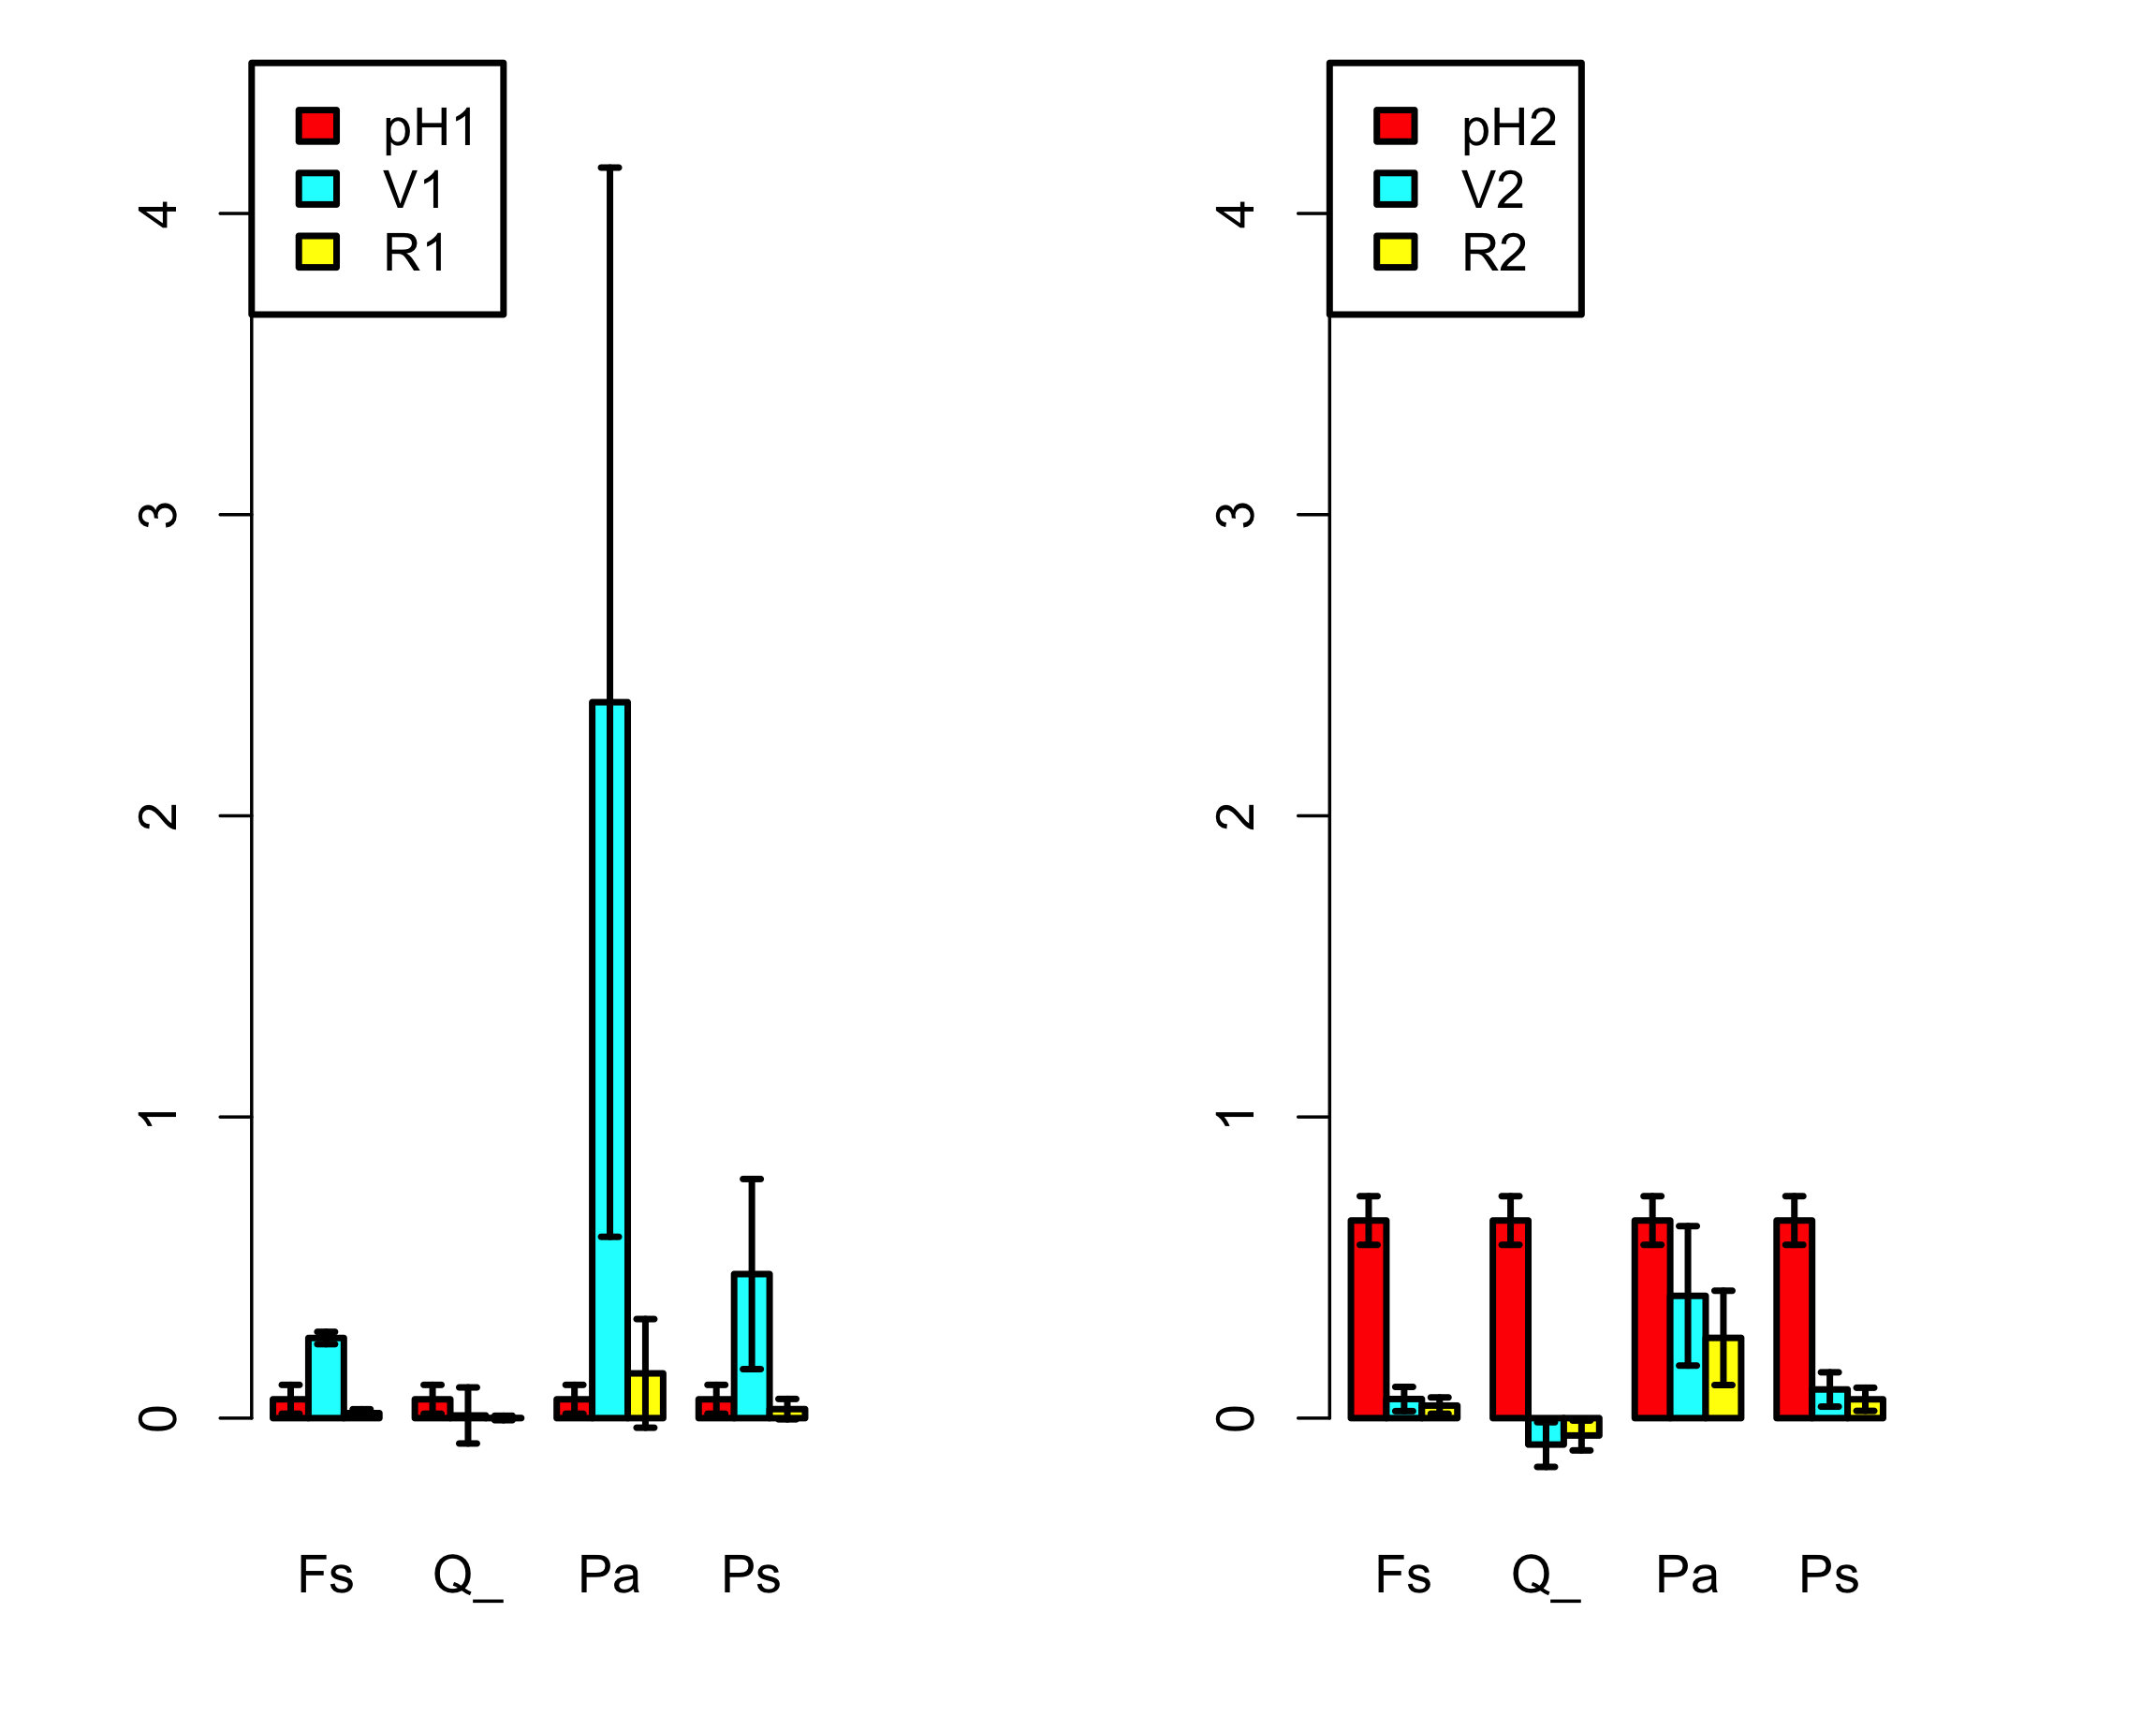
EXERCISE: Forest data from Germany - 2

Slide 53
EXERCISE: Forest data from Germany - 2
Change code: choose a series of multiple thresholds.
Discuss limitations of the multiple-threshold-PRA. Possible answers:
Mostly the same as for the single-threshold PRA.
Low n even more critical here?
…

Slide 54
Continuous single-threshold PRA
Retrieving total (single-threshold) PRA

Slide 55
Extending the PRA from 2 risk-components to 3
64 different
2-component PRAs at cell level:
1 single
3-component PRA at regional level:
P[H] = 0.27
Q = 37/64
V = 0.26
R = 0.04

Slide 56
Extension to R = Q p[H] V
g m⁻² y⁻¹
-
g m⁻² y⁻¹
R = p[H] V
g y⁻¹
m²
g m⁻² y⁻¹
-
R = Q p[H] V
Q = area (or # individuals) exposed to the risk factor

Slide 57
3a. Model-based PRA - 2
USGS CC PDM 1.0
Workshop IBS-Germany & DVFFA, Lübeck, 2025-09-24-26

Slide 58
3b. Interacting hazards
USGS CC PDM 1.0
Workshop IBS-Germany & DVFFA, Lübeck, 2025-09-24-26

Slide 59
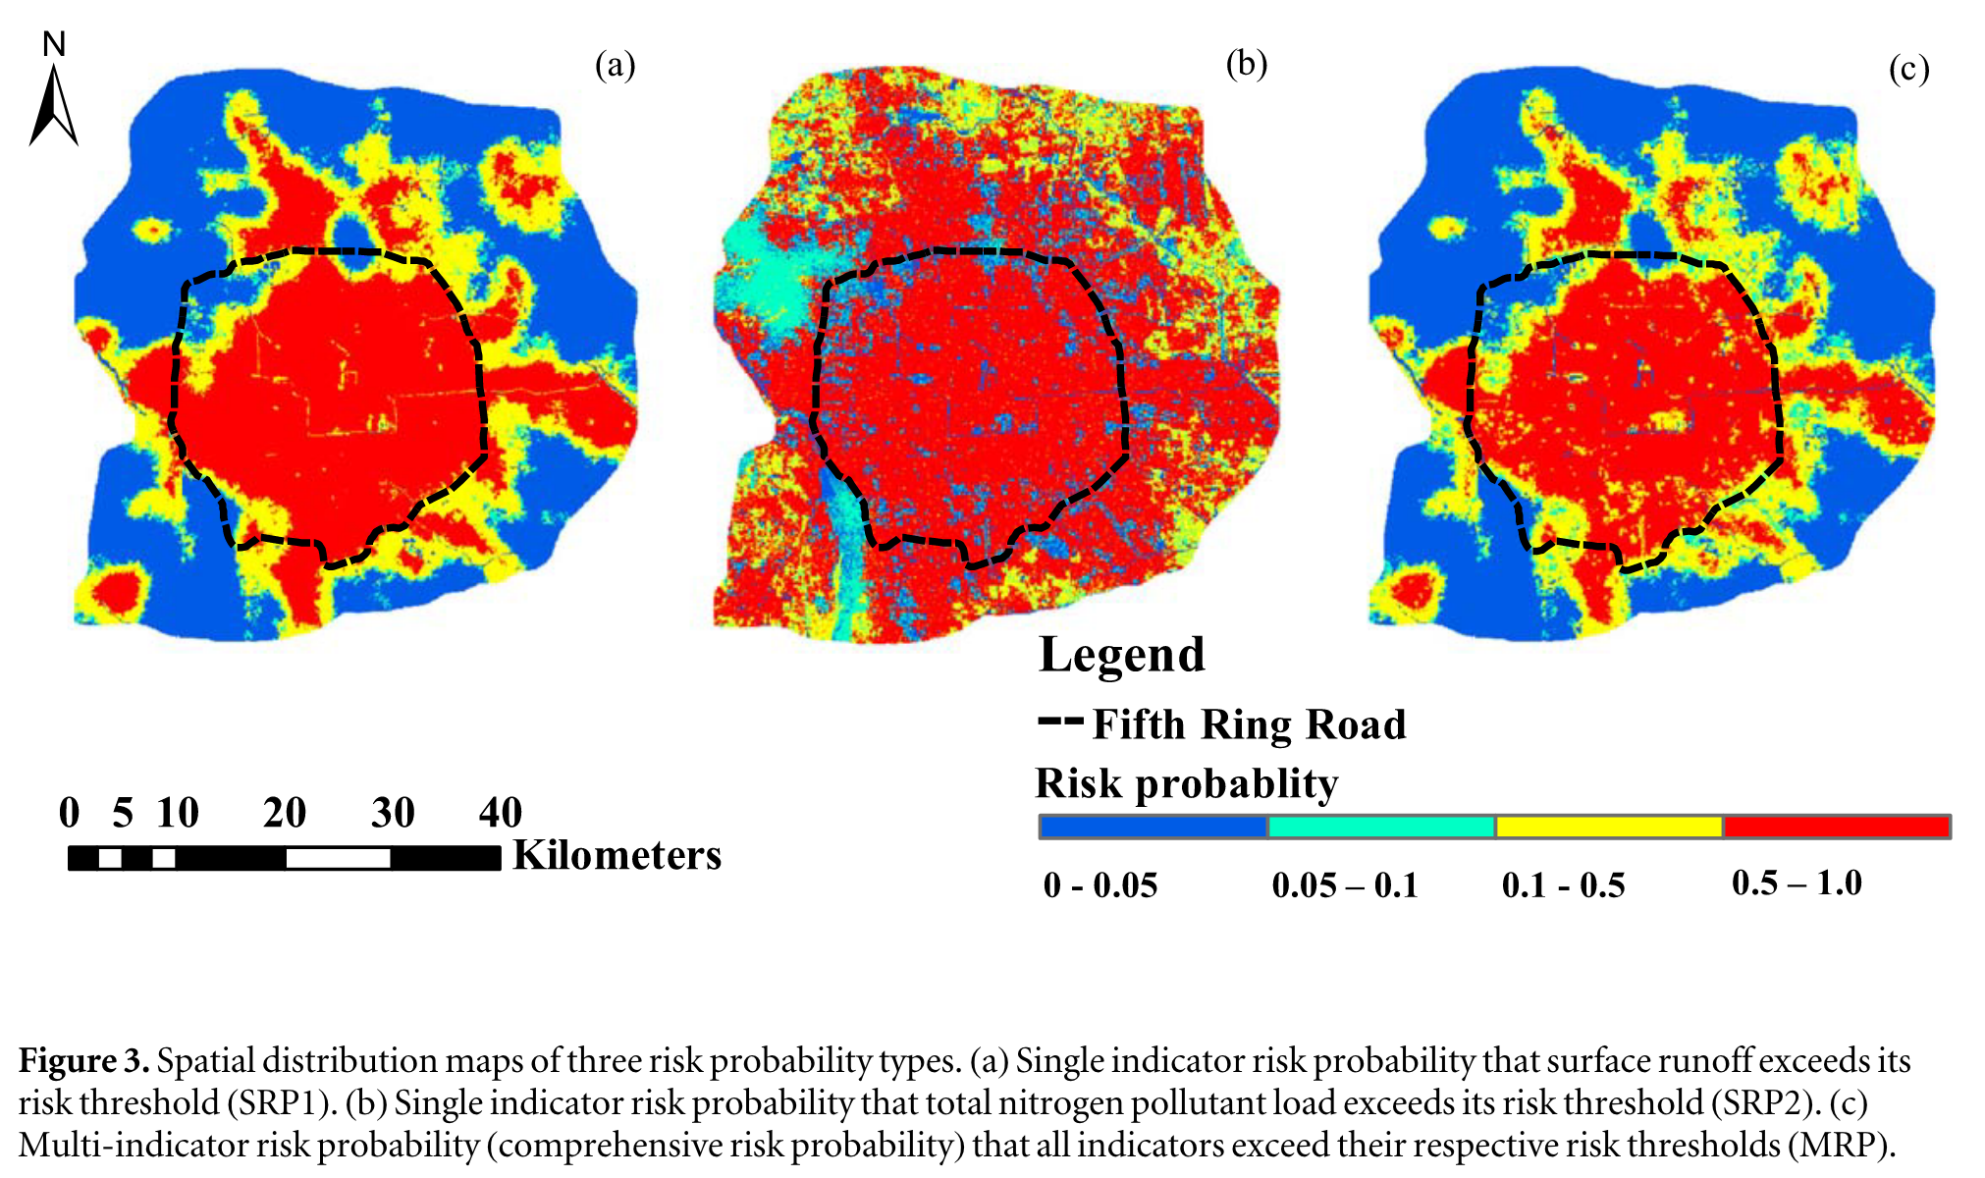
Liu et al. (2020). A new risk probability calculation method for urban ecological risk assessment
Two marginal hazard distributions
Joint distribution formed by copula

Slide 60
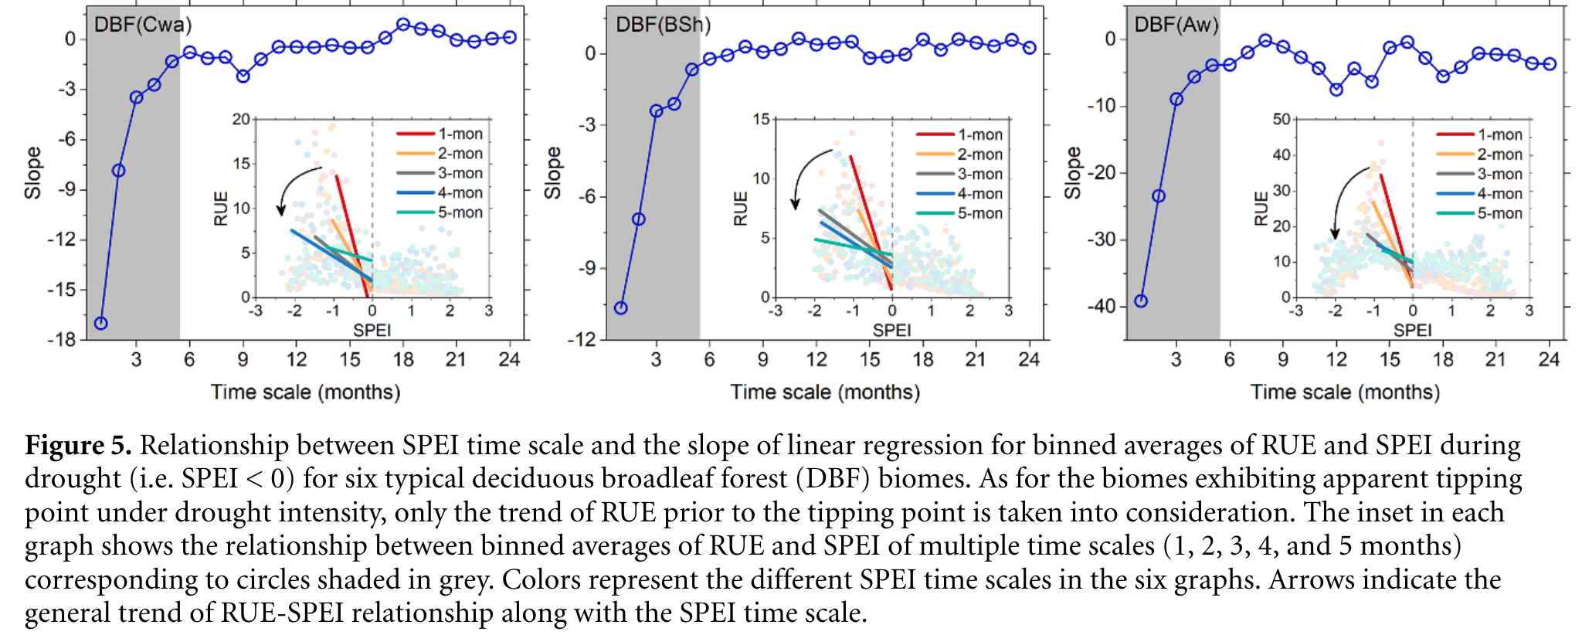
Chen et al. (2020). The collapse points of increasing trend of vegetation rain-use efficiency under droughts

Slide 61
PRA for heatwaves (T>30°C) as f(mean(T),sd(T))

Slide 62
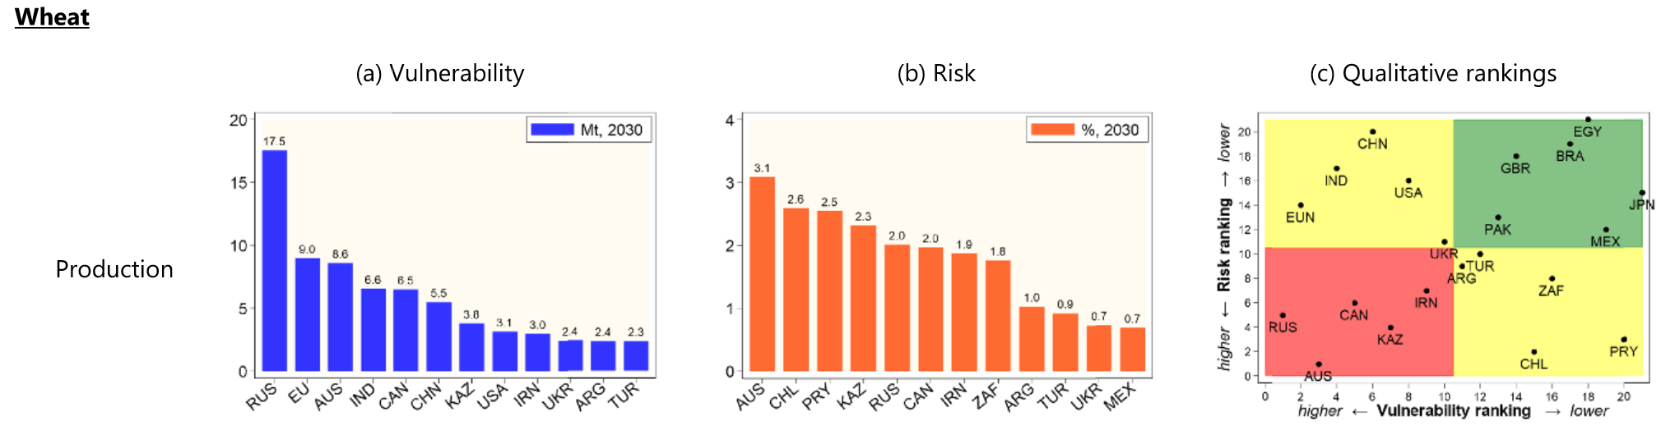
Chatzopoulos et al. (2021). Potential impacts of concurrent and recurrent climate extremes on the global food system by 2030
Concurrent climate extremes
Recurrent climate extremes
V_{glob} = f(spatial distrib. of H)
V_{glob} = f(temporal distrib. of H)

Slide 63
Example of H-interaction with modelled data
Make models that generate values for two or three different hazards. Examine two different versions:
Assume the p[Hi] are independent
Assume correlations
See my handwritten note (single A4)

Slide 64
4a. Introduction to BDT
USGS CC PDM 1.0
Workshop IBS-Germany & DVFFA, Lübeck, 2025-09-24-26

Slide 65
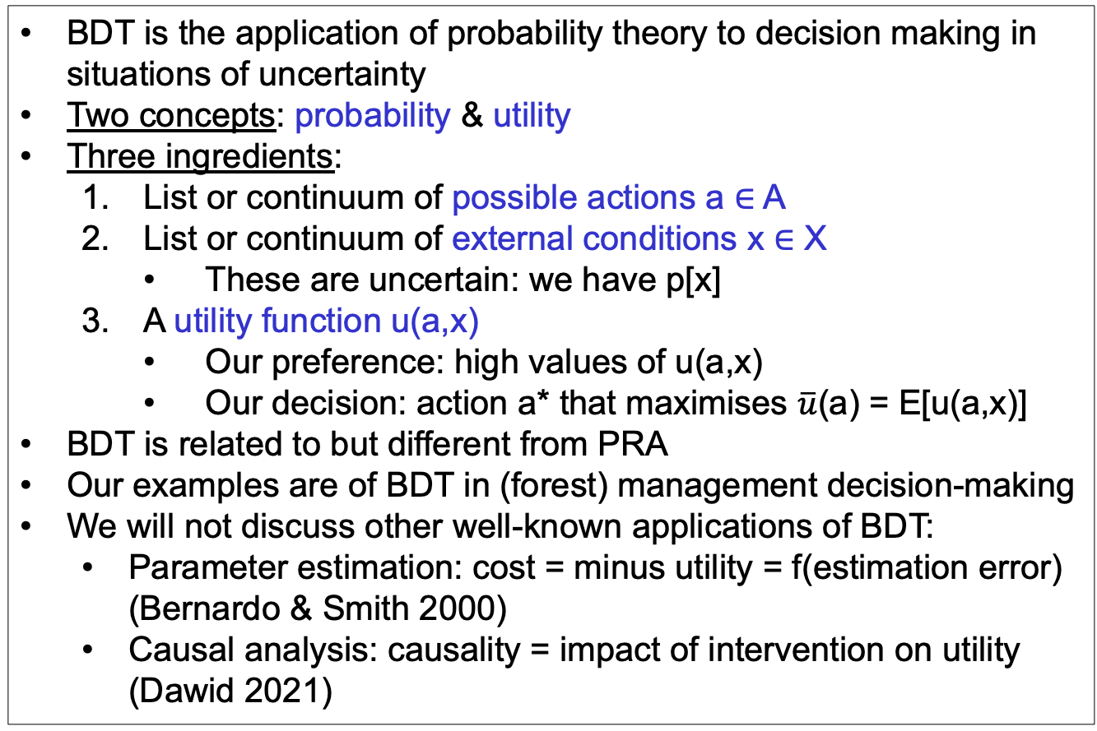
Bayesian Decision Theory (BDT)
BDT is the application of probability theory to decision making in situations of uncertainty
Two concepts: probability & utility
Three ingredients:
List or continuum of possible actions a ∈ A
List or continuum of external conditions x ∈ X
These are uncertain: we have p[x]
A utility function u(a,x)
Our preference: high values of u(a,x)
Our decision: action a* that maximises $\overline{u}$(a) = E[u(a,x)]
BDT is related to but different from PRA
Our examples are of BDT in (forest) management decision-making
We will not discuss other well-known applications of BDT:
Parameter estimation: cost = minus utility = f(estimation error) (Bernardo & Smith 2000)
Causal analysis: causality = impact of intervention on utility (Dawid 2021)

Slide 66
Graphical models: From PRA to BDT
PRA
BDT
u
z
z
x
a
x
p[x,z] =
p[x] p[z|x]
p[x,z,u|a] =
p[x] p[z|a,x] p[u|a,z]

Slide 67
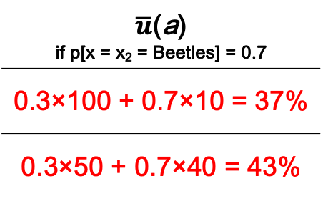
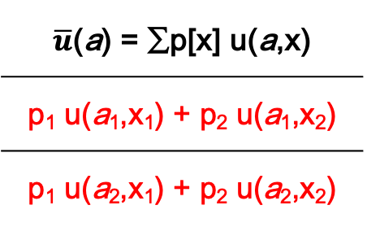
Utility matrix for discrete u(a,x)
 | x = x₁ | x = x₂
a = a₁ | u(a₁,x₁) | u(a₁,x₂)
a = a₂ | u(a₂,x₁) | u(a₂,x₂)
$\overline{u}$(a) = ∑p[x] u(a,x)
p₁ u(a₁,x₁) + p₂ u(a₁,x₂)
p₁ u(a₂,x₁) + p₂ u(a₂,x₂)
u
z
% Tree survival | No beetles | Beetles
No thin | 100% | 10%
50% thin | 50% | 40%
$\overline{u}$(a) if p[x = x₂ = Beetles] = 0.7
0.3×100 + 0.7×10 = 37%
0.3×50 + 0.7×40 = 43%
a
x
We want to maximise expected utility $\overline{u}$(a), so we choose a₂

Slide 68
Value of Information: Impact on expected utility
Only prior information p[x]:
Specific information y:
Information yet to be received Y = {y}:
‘Perfect’ information so you can always (for every x) choose the best action:

Slide 69
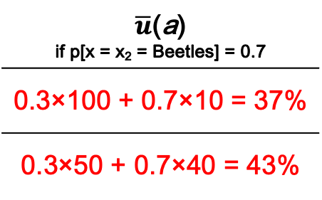
Value of Information in the tree beetle example
If y = {y₁,y₂} and
p[y₁|x₁] = p[y₂|x₂] = 0.6
u
VoI_{partial} = 43.6 – 43 = 0.6%
VoI_{perfect} = 58 – 43 = 15%
z
% Tree survival | No beetles | Beetles
No thin | 100% | 10%
50% thin | 50% | 40%
$\overline{u}$(a) if p[x = x₂ = Beetles] = 0.7
0.3×100 + 0.7×10 = 37%
0.3×50 + 0.7×40 = 43%
a
x

Slide 70
Value of Bad Information in the tree beetle example
What would happen to VoI_{partial} if p[y₁|x₁] = p[y₂|x₂] = 0.5?

Slide 71


Decision tree
u₁₁ = 100%
No beetles
p=0.3
x
$\overline{u}$(a₁) = 37%
No thin
Beetles
p=0.7
u₁₂ = 10%
a
Thin
No beetles
p=0.3
u₂₁ =50%
x
$\overline{u}$(a₂) = 43%
Beetles
p=0.7
u₂₂ =40%

Slide 72
Sequential decisions
No beetles
p=0.3
x
No thin
Beetles
p=0.7
a
Thin
No beetles
p=0.3
x
Beetles
p=0.7

Slide 73
Graphical models: From PRA to BDT
PRA
BDT
u
u
u
cost
benefit
cost
benefit
z
z
z
z
𝜺
x
a
x
a
x
a
x
𝝑
p[x,z] =
p[x] p[z|x]
p[x,z,u|a] =
p[x] p[z|a,x] p[u|a,z]
z = f(a,x,𝝑) + 𝜺
p[x], p[𝝑], p[𝜺]

Slide 74
BDT for forestry
Utility
u
Management costs
cost
benefit
Timber sale
Forest growth
z
𝜺
Model error
Management actions
a
x
𝝑
Model parameters
Climate

Slide 75
Ignoring uncertainties and errors for a moment ...
100.00
--------
Model
YC = £ 180.00 ha⁻¹ y⁻¹
WUE
Irrigation
u
YC
Rain
200.00
-----
300.00
--------
z = 0.01 (x + a)
u = 30 z - 0.5 a
£ 0.00
ha⁻¹ y⁻¹
cost
benefit
£ 180.00 ha⁻¹ y⁻¹
Timber
price
Irrigation costs
10
---
YC = 6
m³ ha⁻¹ y⁻¹
z
𝜺
a
x
𝝑
400
--
Irrigation = 0 mm y⁻¹
Rain = 600 mm y⁻¹
WUE = 0.01
m³ ha⁻¹ mm⁻¹

Slide 76
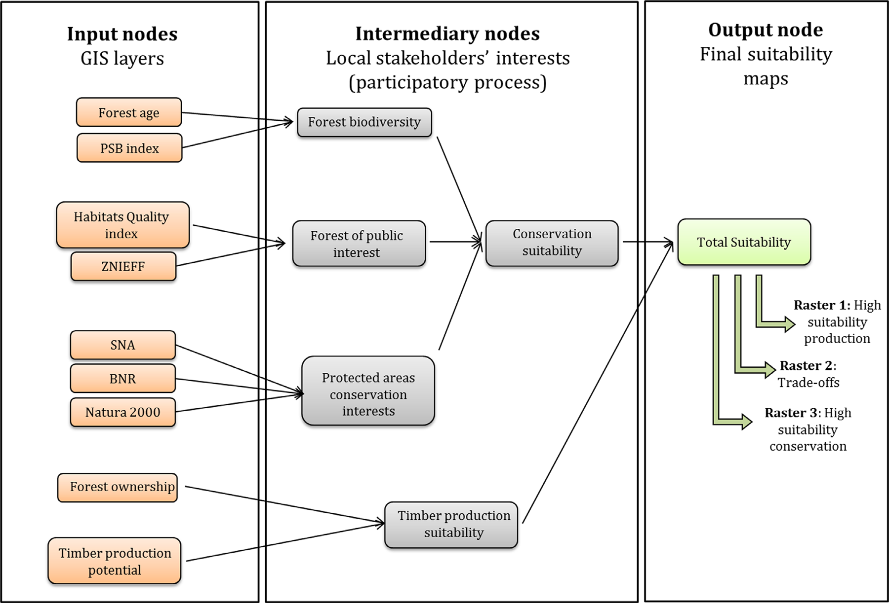
Gonzales-Redin et al. (2016)
Gonzalez Redin, J. et al. (2016). Spatial Bayesian belief networks as a planning decision tool for mapping ecosystem services trade-offs on forested landscapes. Environmental Research 144: 15-26.

Slide 77
Now with all uncertainties!
u
E[u|a] = ∫ E[u(a,x)] p[x] dx
cost
benefit
E[u(a,x)] = ∫ ∫ p[z|x,θ,a] p[θ|y] dθ p[x] dx
z
𝜺
p[ε]
p[θ|y]
p[x]
a
x
𝝑
z = f(a,x,𝝑) + 𝜺
p[x], p[𝝑], p[𝜺]
p[ε_{y}]
p[θ]

Slide 78
4b. Links between PRA and BDT
USGS CC PDM 1.0
Workshop IBS-Germany & DVFFA, Lübeck, 2025-09-24-26

Slide 79
4c. General discussion
USGS CC PDM 1.0
Workshop IBS-Germany & DVFFA, Lübeck, 2025-09-24-26

Slide 80
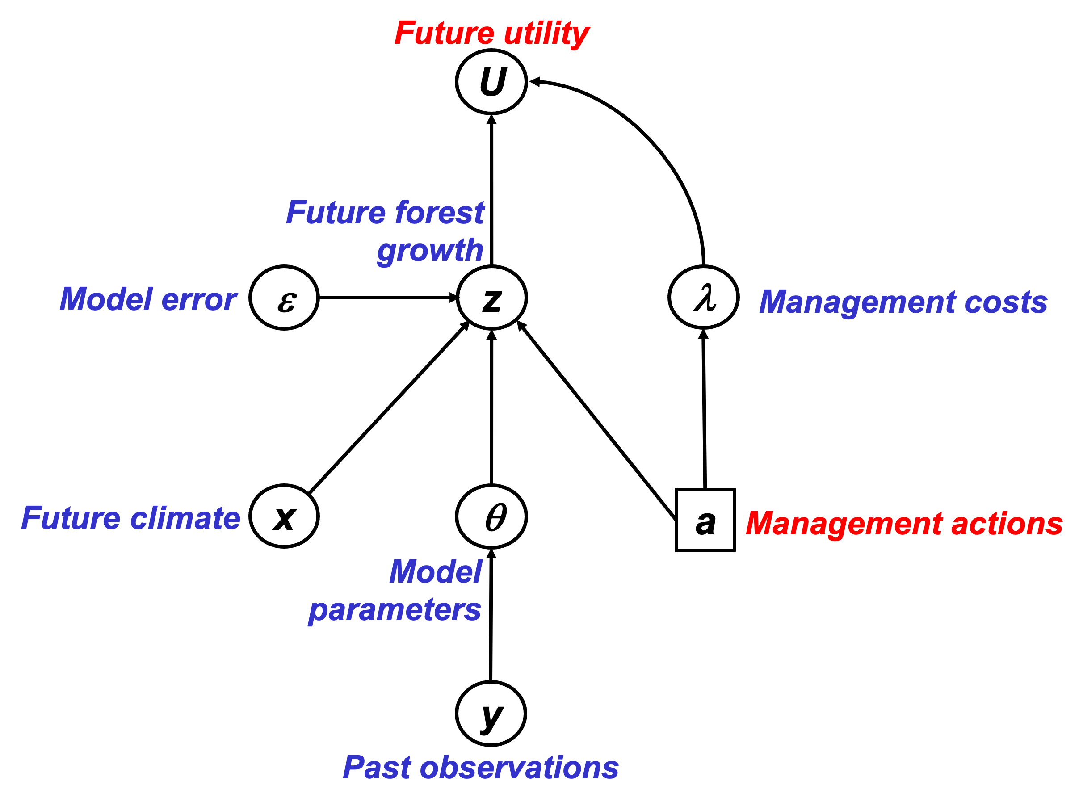
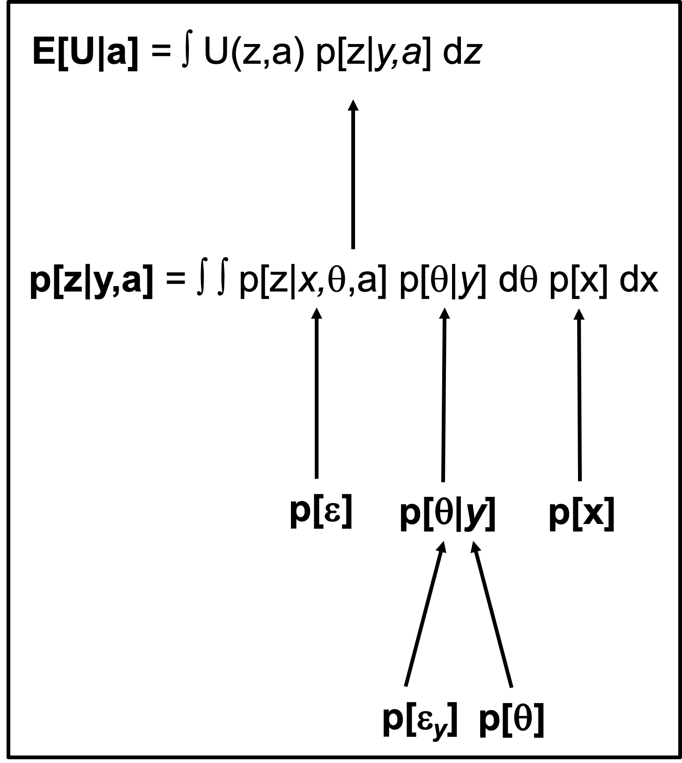
Theory development: PRA & BDT
Probabilistic Risk Analysis (PRA)
Risk = Expected loss = probability(Hazard) * Vulnerability
p(Drought)
Risk
Vulnerability
Van Oijen et al. (2013, 2014, 2019)
Bayesian Decision Theory
(BDT)

Slide 81

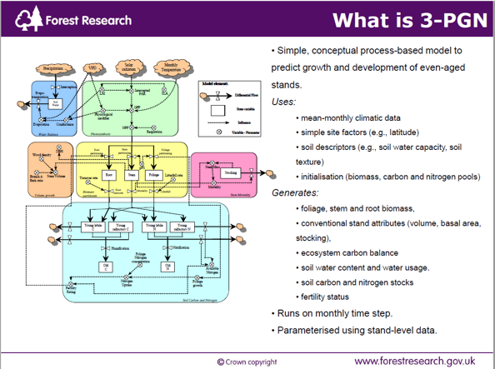
Data & Process-Based Modelling (PBM)
Data
Performance of conifer spp. in UK, Spain, Finland
Environmental conditions (soil, past & future climate)
Forest management
Model drivers
Model test data
Model calibration data
PBM
BASFOR, 3PGN, …
Quantifying past & future forest performance
Analysing forest vulnerability to drought
Analysing impacts of management

Slide 82
Project flowchart & Decision Support System (DSS)
Data
PRA
DSS
PBM
BDT

Slide 83
Deeper analysis of p[H] and V
Analysing p[H]. Compare with FTA in systems with binary outcomes. Use BBN. Or PBM.

Slide 84
Lecina-Diaz et al. (2020)

Slide 85
Lecina-Diaz et al. (2020)

Slide 86
PRAFOR (2020-2022) - Why?
Need to know where/what to plant to ensure 'climate-smart' forestry (carbon sequestration)
To underpin land-use decision making needs information on risks in a way that supports decisions making to mitigate drought (and other) risks.

Slide 87
PRAFOR objectives
1. Show under which conditions p[H], E and V can be treated as independent variables.
2. Show under which conditions uncertainties in p[H], E and V can be quantified analytically.
3. Derive numerical approximation algorithms for non-analytical conditions.
4. Show how the PRA is a special case of Bayesian Decision Theory and compare strengths and weaknesses of PRA vs. full BDT.
5. Use observational data to analyse risks from global change to forests in the UK, Spain and Finland.
6. Use outputs from forest simulation modelling to predict and analyse future risks.
7. Analyse the simulation model to identify the key system properties that determine vulnerability.
8. Produce an interactive app for probabilistic risk analysis including uncertainty quantification.
Theory
Application
Analysis
Process sensitivities, Lag-effects, Adaptation, ...
Communication

Slide 88
Outlook
Theory has been tested on virtual data sets, confirming the accuracy of formulas for uncertainty quantification
Next steps:
Application to real forest data
PRA theory to be embedded in Bayesian decision-theory (BDT) framework
PRA or BDT to be embedded in ESC, the existing Decision Support System of Forest Research U.K.

Slide 89
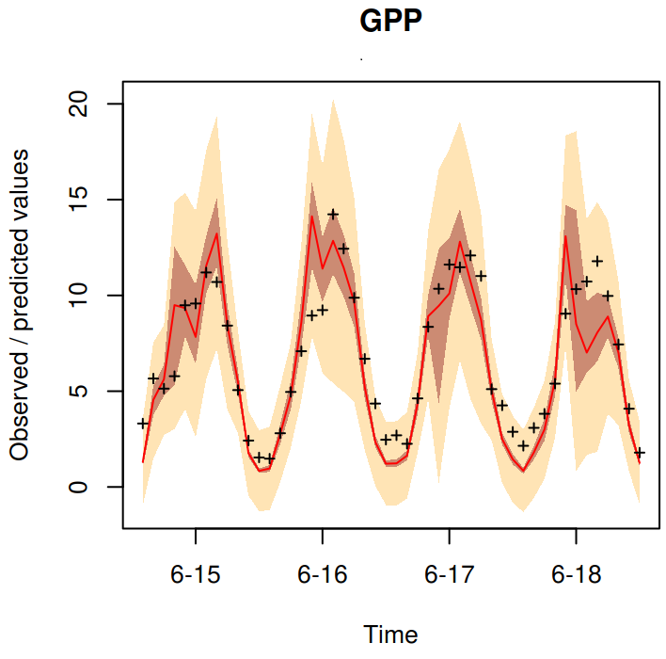
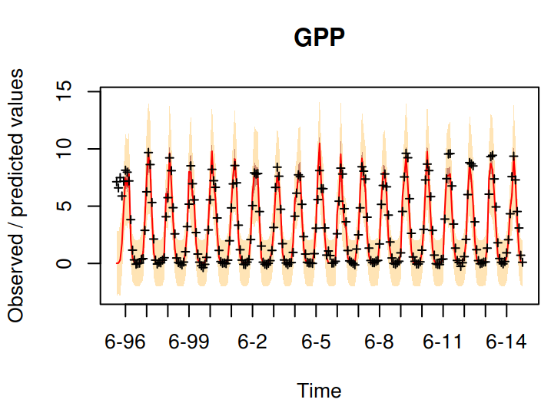
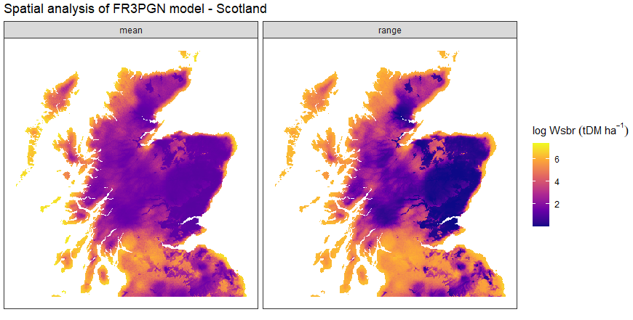
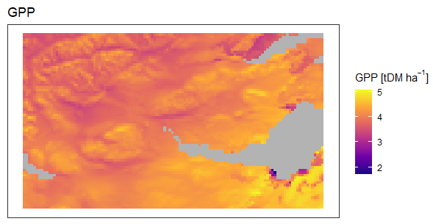
Process-model based drought vulnerability
Two process-based models (BASFOR, 3PGN)
Identify key factors drive present and future forest drought vulnerability.
Bayesian Calibration to reduce uncertainty in model parameters
Forest data (UK, Spain and Finland)
Quantify uncertainty in model error.

Slide 90
ESC: a DSS for tree suitability estimation
• National scale guidance published in 2001.
• Complemented by a computer based decision support system, field survey pack and training course.
• ArcView extension.
• Now embedded in many aspects of GB Forestry.

Slide 91
PRAFOR objectives
1. Show under which conditions p[H], E and V can be treated as independent variables.
2. Show under which conditions uncertainties in p[H], E and V can be quantified analytically.
3. Derive numerical approximation algorithms for non-analytical conditions.
4. Show how the PRA is a special case of Bayesian Decision Theory and compare strengths and weaknesses of PRA vs. full BDT.
5. Use observational data to analyse risks from global change to forests in the UK, Spain and Finland.
6. Use outputs from forest simulation modelling to predict and analyse future risks.
7. Analyse the simulation model to identify the key system properties that determine vulnerability.
8. Produce an interactive app for probabilistic risk analysis including uncertainty quantification.
Theory
Application
Analysis
Process sensitivities, Lag-effects, Adaptation, ...
Communication

Slide 92
NOTES
German example (internet data): make local by using SPEI?

Slide 93
Appendices
USGS CC PDM 1.0
Workshop IBS-Germany & DVFFA, Lübeck, 2025-09-24-26

Slide 94
Condition for V being threshold-independent

Slide 95
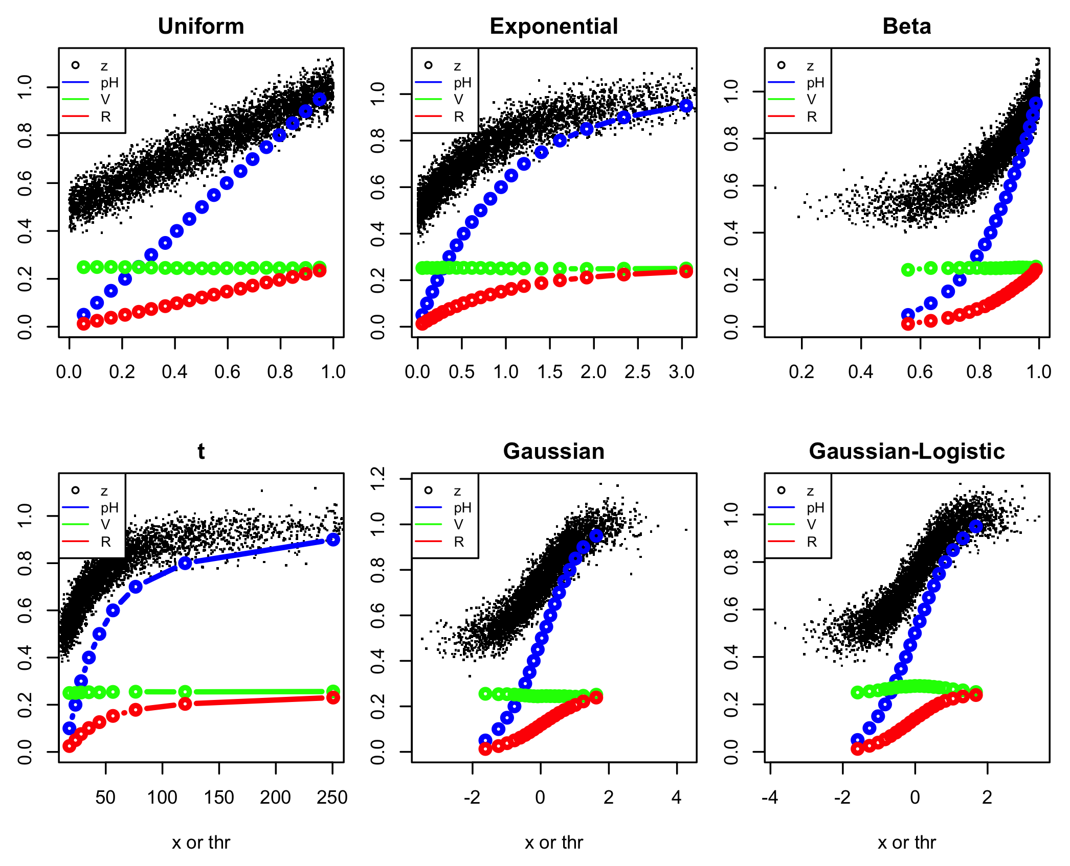
PRA on datasets where E[z|x] = a + b F_{x}[x] + 𝜺

